Slide 1
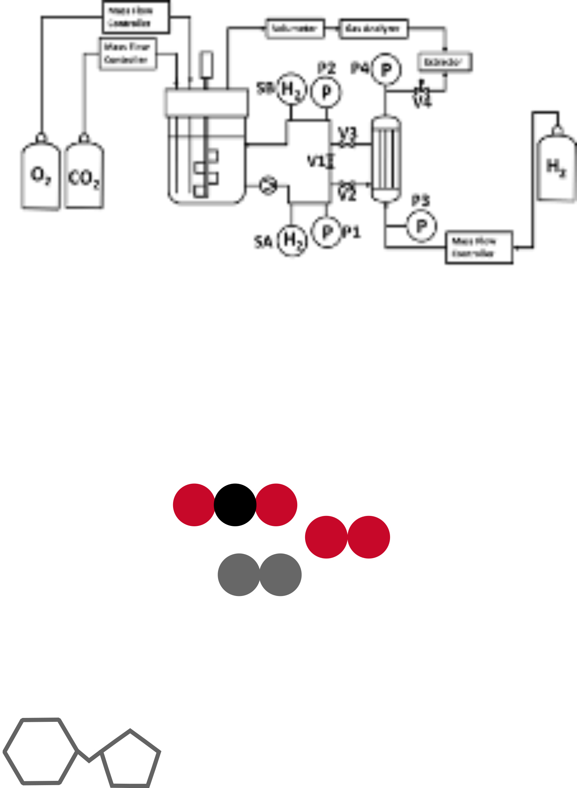

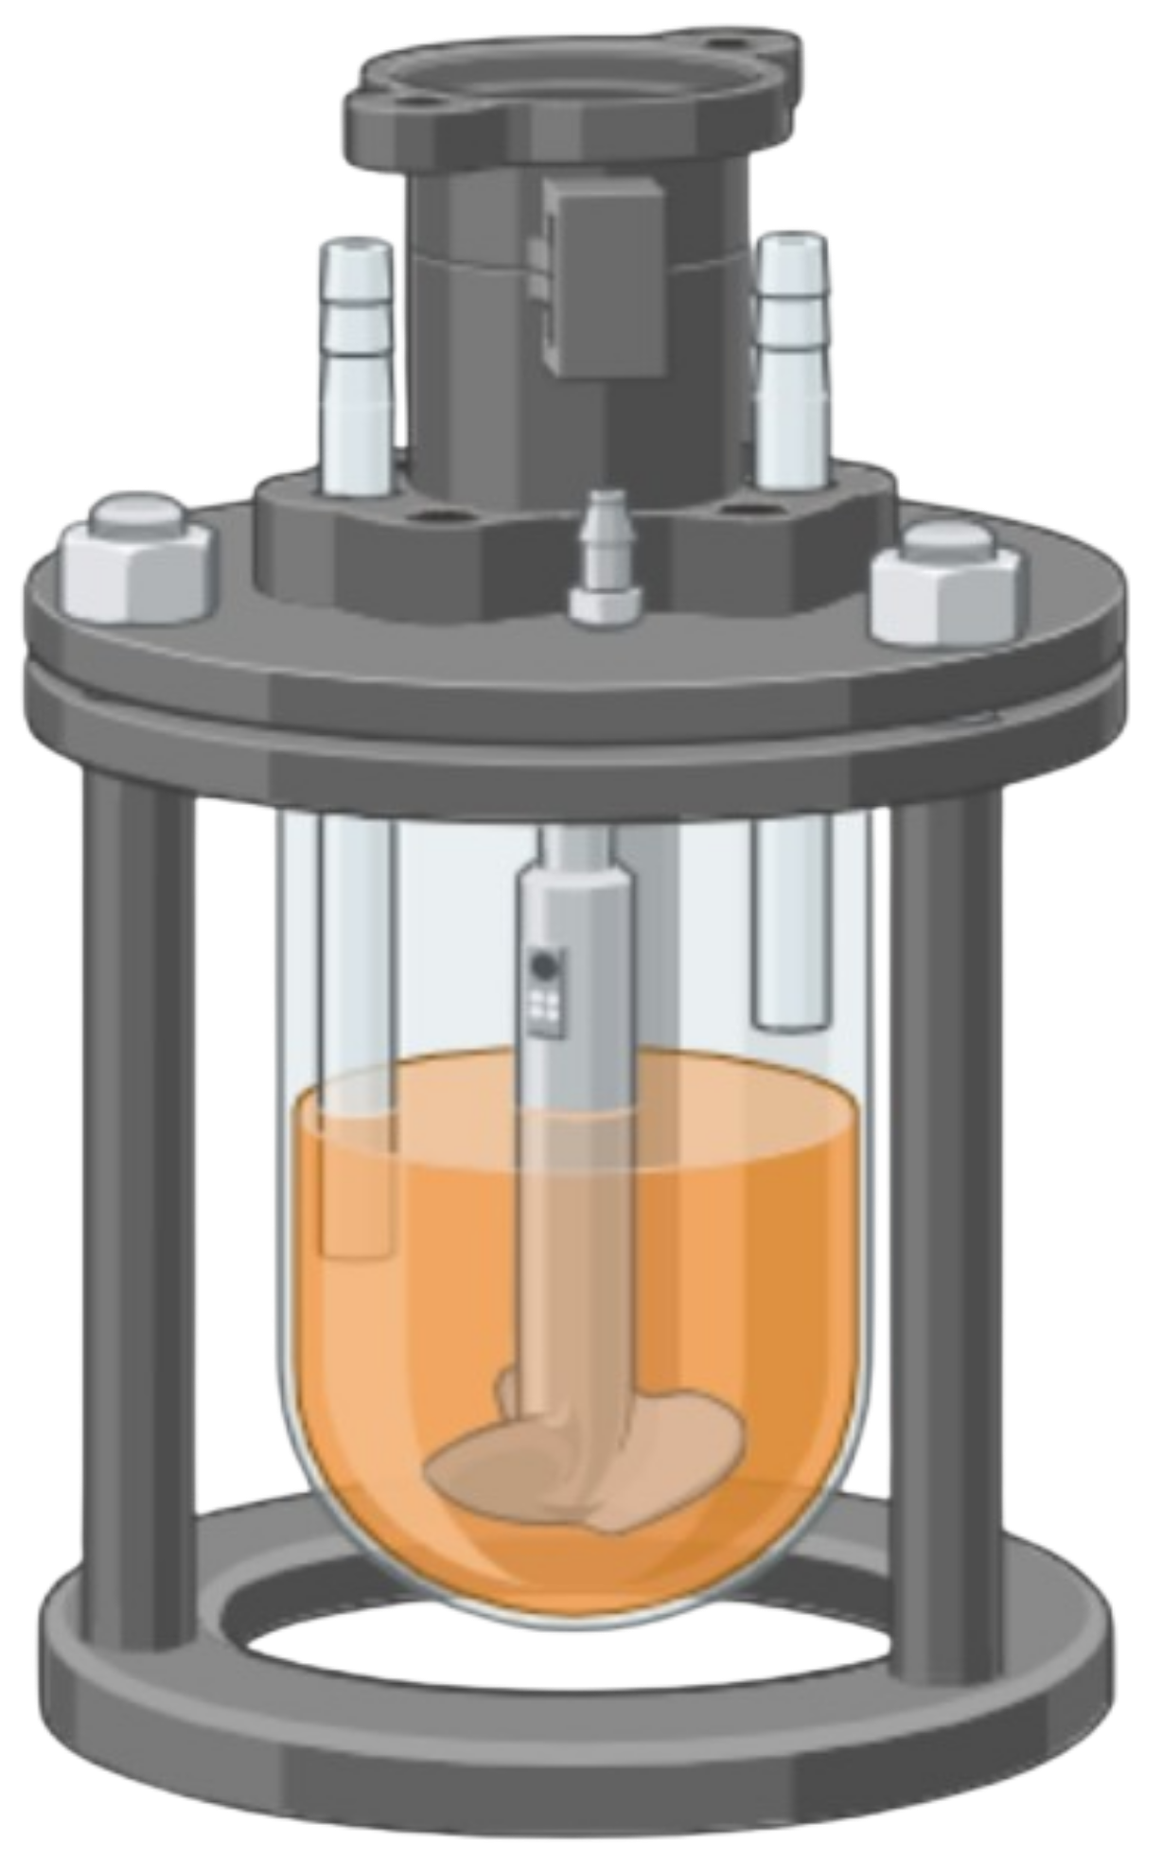


This project has received funding from the European Union’s Horizon 2020 research and innovation programme under the Marie Skłodowska-Curie grant agreement No 955740.
Work-package 3:
Developing autotrophic processes to meet industrial demands
Halima Aliyu Alhafiz, Federico Di Bisceglie, Pauline Pijpstra and Isabell Weickardt
12th November 2024
Notes:
Hello everybody,
I want to talk to you about a world where CO2 is not only a problem but also a raw material because thanks to bacteria we can transform it into valuable chemicals like IPA

Slide 2
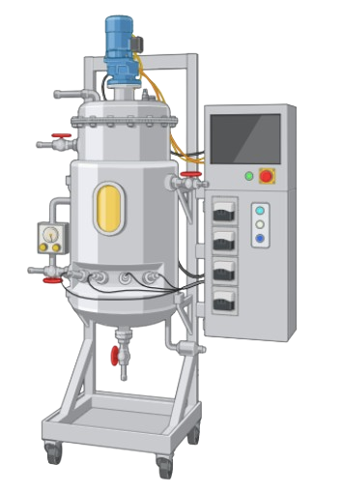
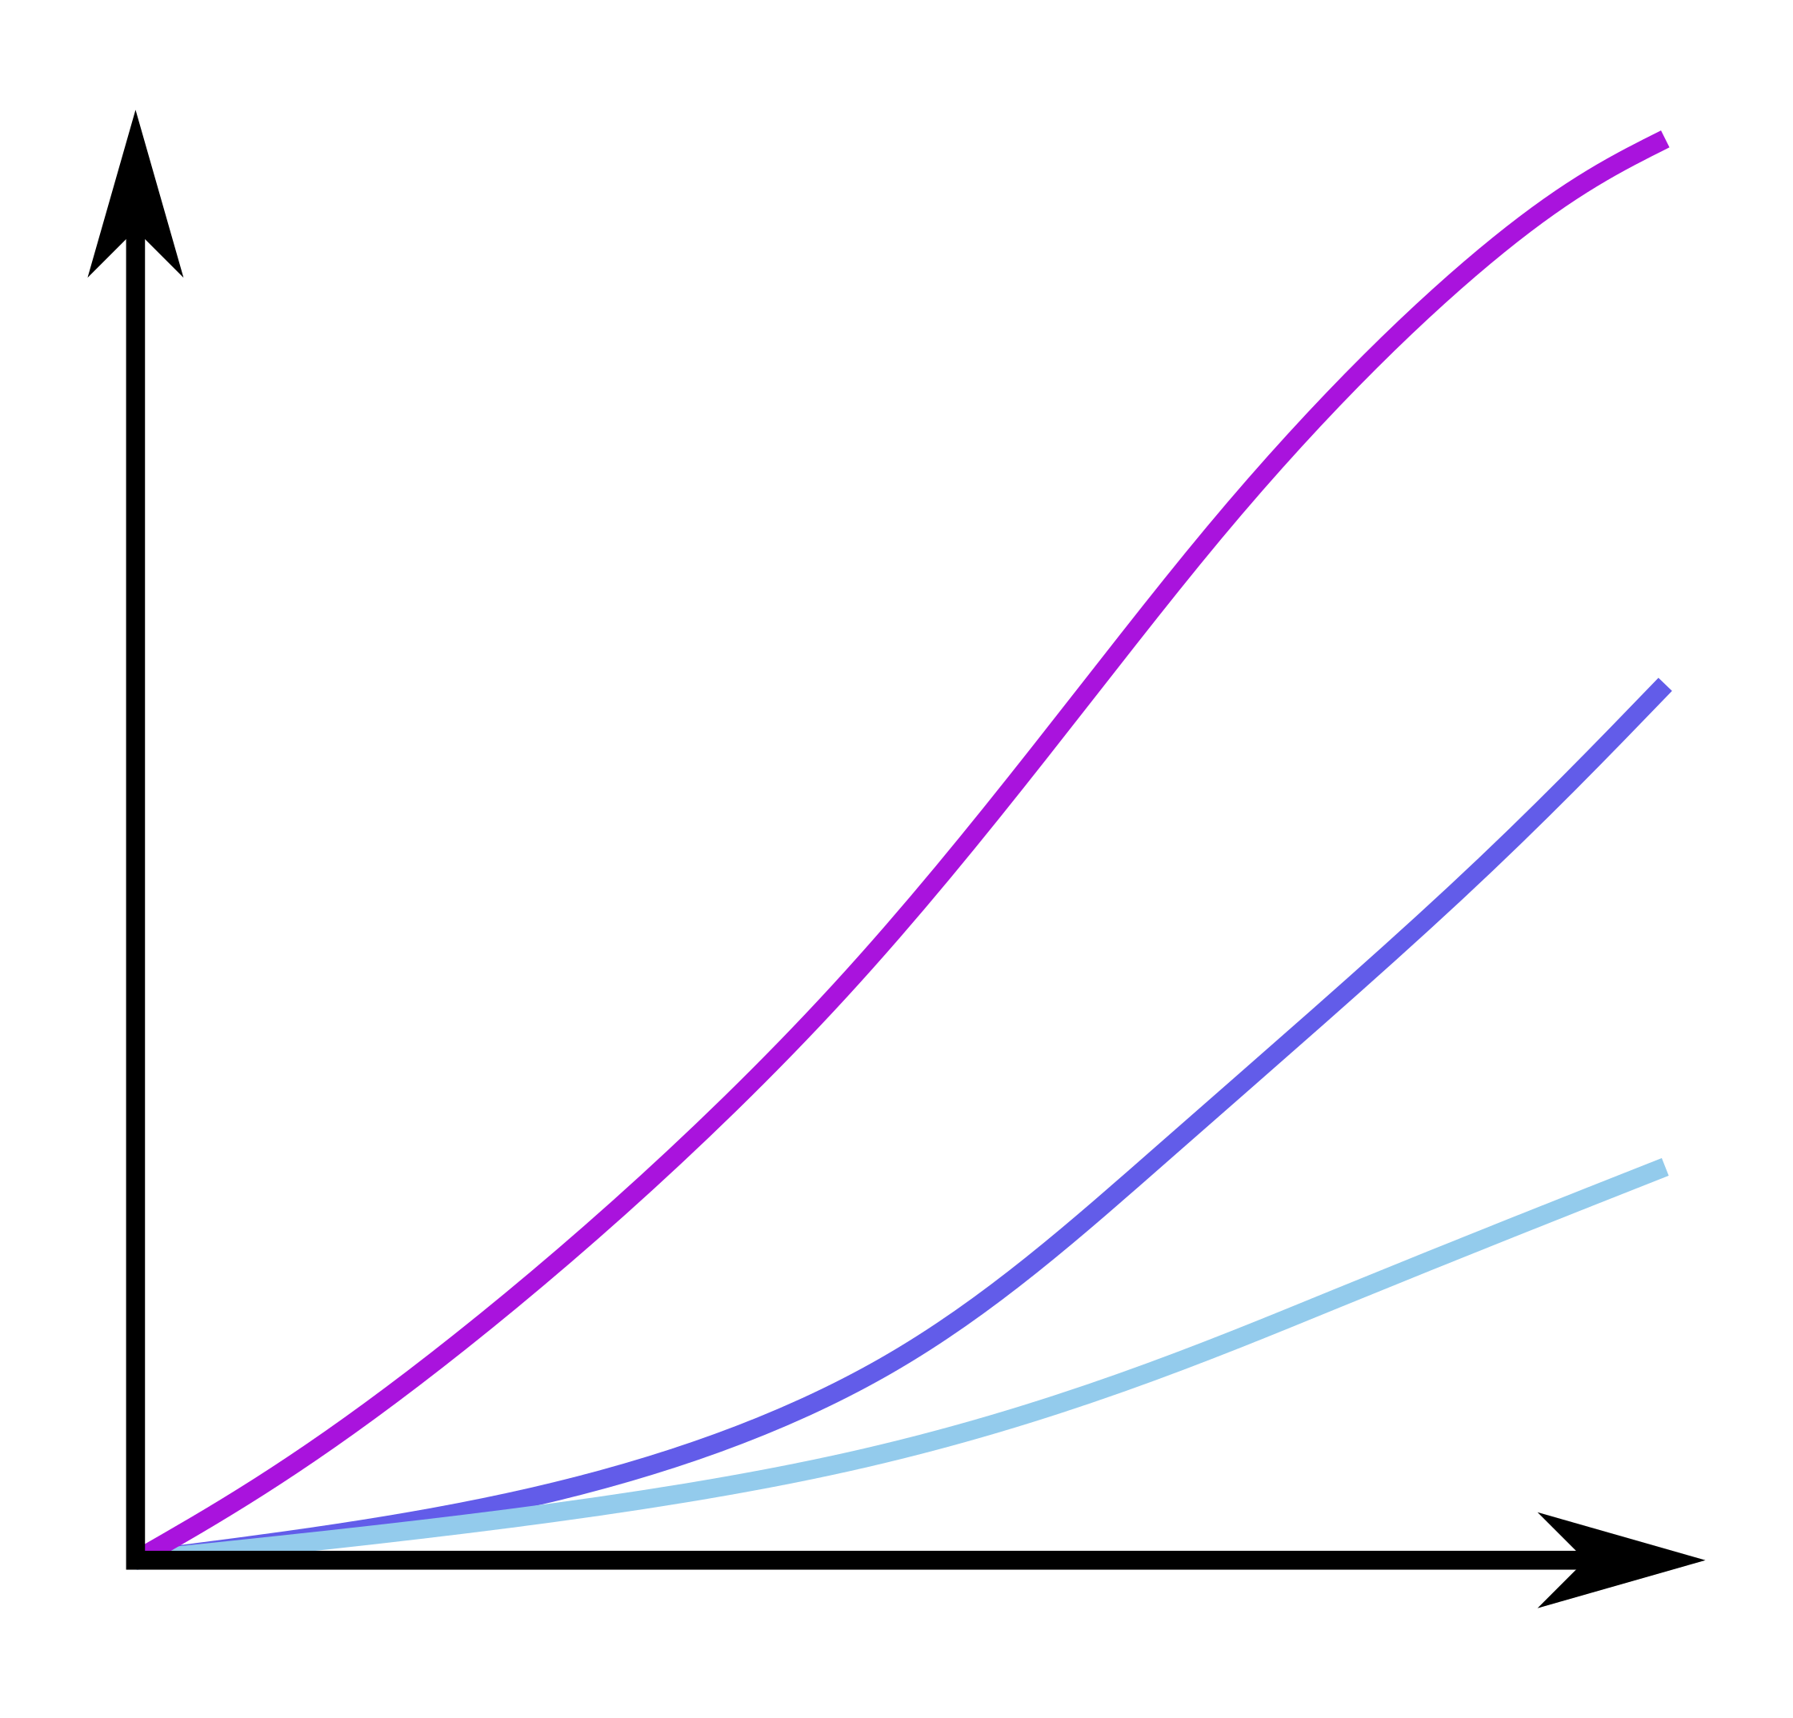

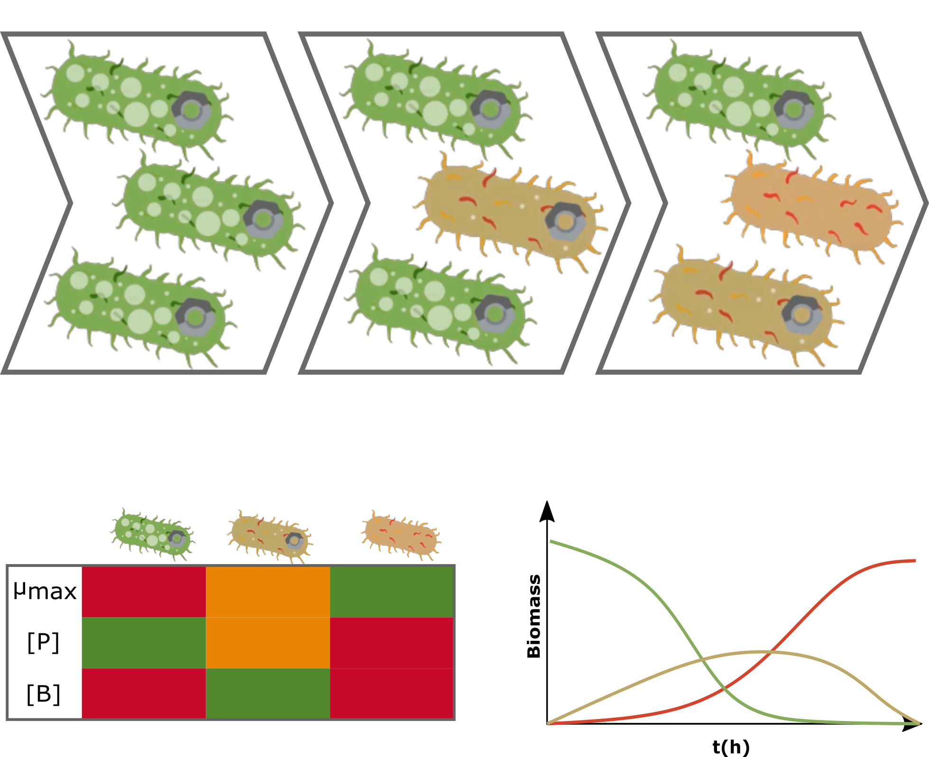
H₂ <4%
O₂ <4%
Cultivations at all scales
Safe and effective cultivations
Robust analytics and control
Reactor Development
High cell density gas fermentation
Speeding up development bioprocesses from CO₂
Increasing robustness of processes
Robust bioprocesses
Robust strains
Reactor design
k_{L}a
Media
composition
Gas solubility
Notes:
Current bottlenecks are :
the difficulty to efficiently transfer gas at gas-liquid interfaces (resulting in limited cell densities)
the explosion risk associated with mixtures of hydrogen and oxygen above a critical concentration of 4% hydrogen and 6% of oxygen
the difficulties to provide robust and practicable analytics to control the gas supply
the uncertainty of robustness of engineered microbes in autotrophy

Slide 3
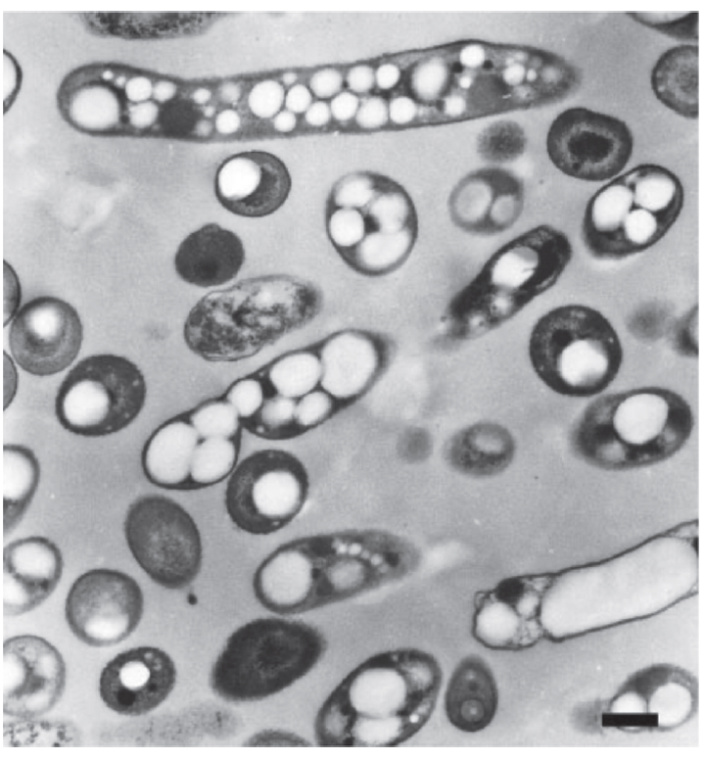
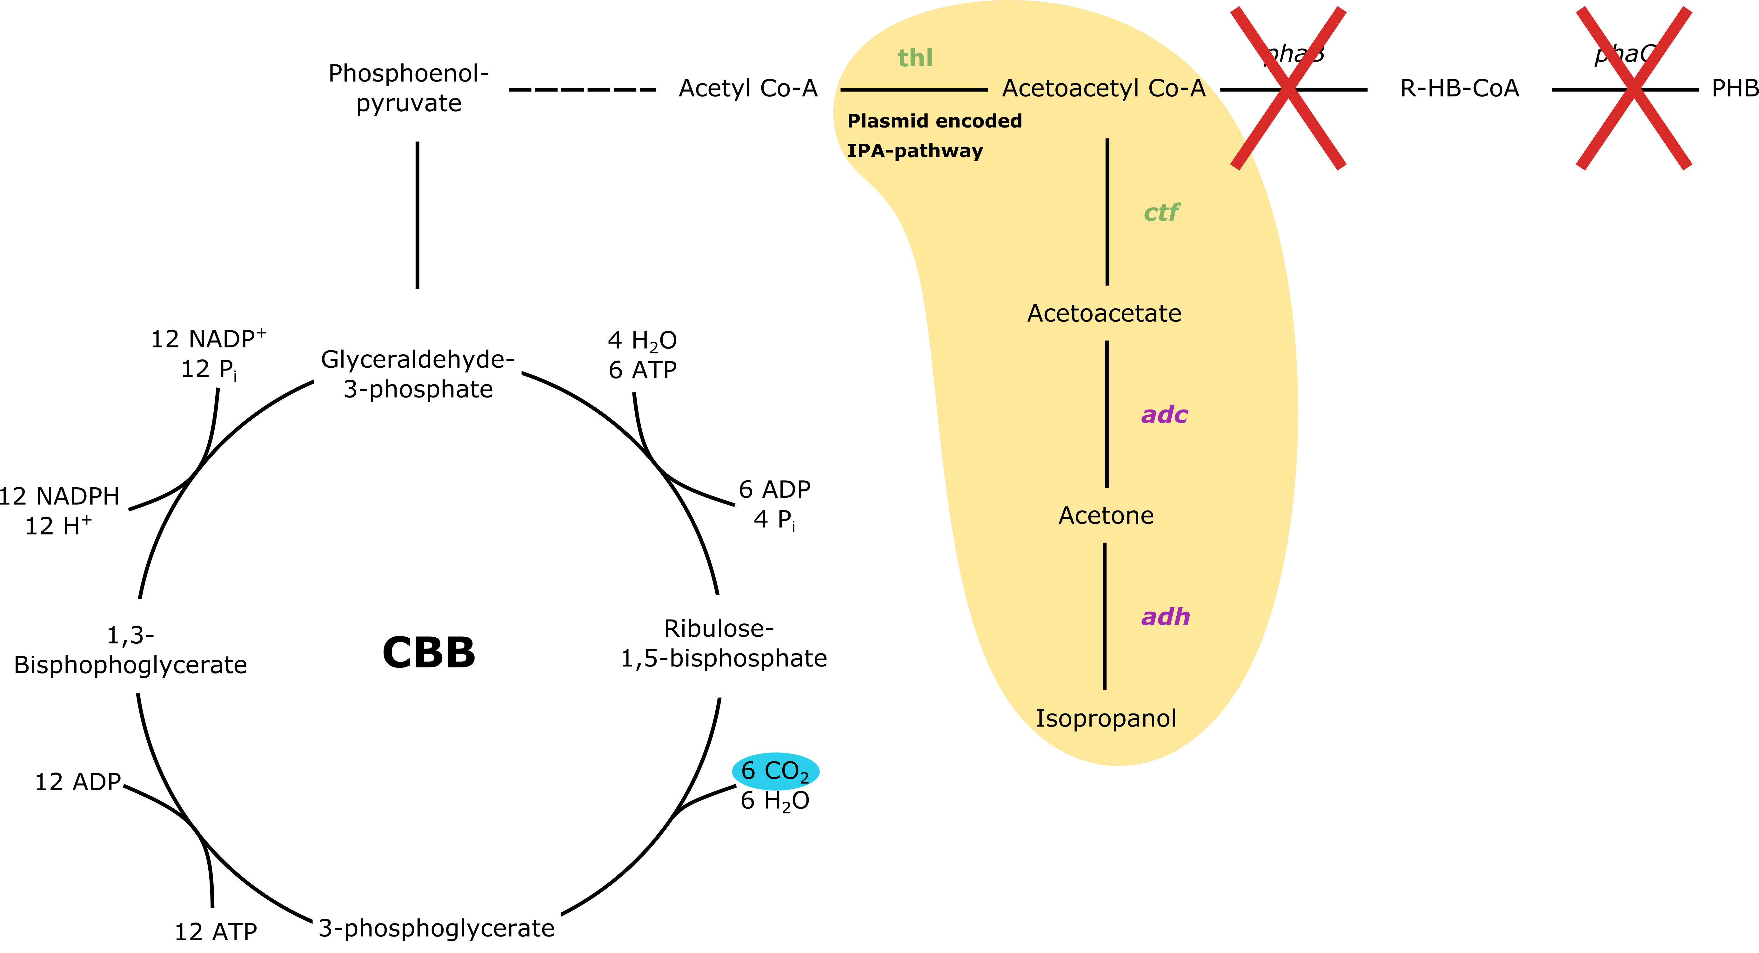
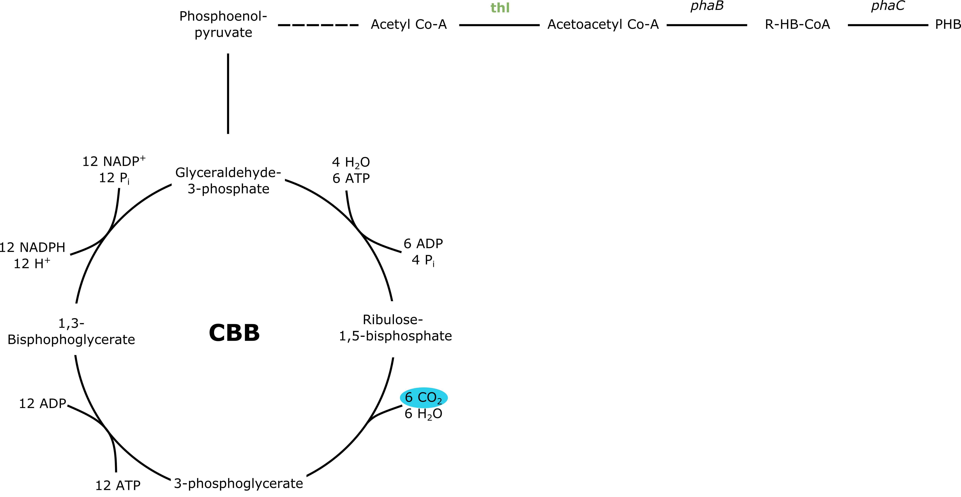
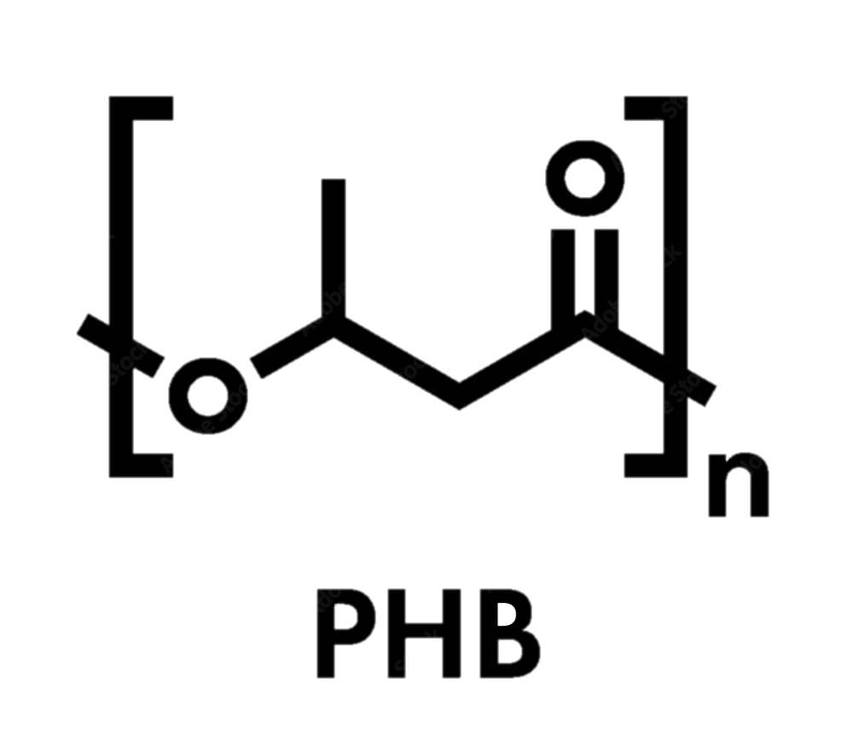
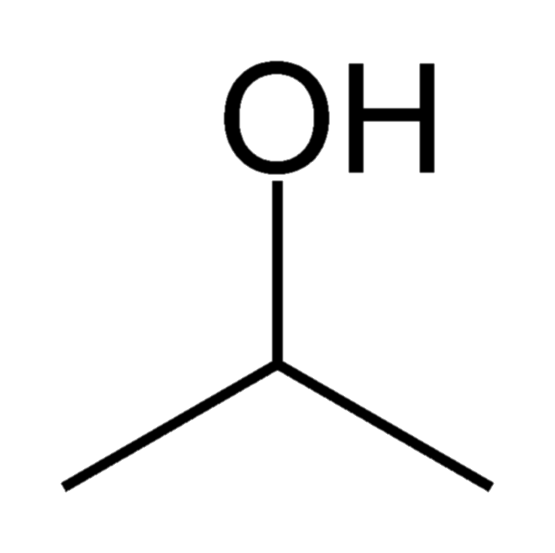
Cupriavidus necator as a chassis organism
Panich et al. 2021
Cupriavidus necator
Storage molecule
PHB
Bioplastic
Disinfectant
Isopropanol
Platform chemical
THL - ketothiolase CTF –acetoacetyl-CoA-transferase
ADC - acetoacetate decarboxylase ADH - alcohol dehydrogenase
Overexpresssed native genes- Clostridium sp. genes
Notes:
Cupri well researched as modell organism for PHB production
PHB storage compound formed from wildytpe under unbalanced conditions
IPA pathway: plasmid based, overexpressed native genes, 2 heterologously expressed
Transition to next slide: point to autotrophic metabolism: need H2 and O2 -> explosive, gasses low solubility

Slide 4
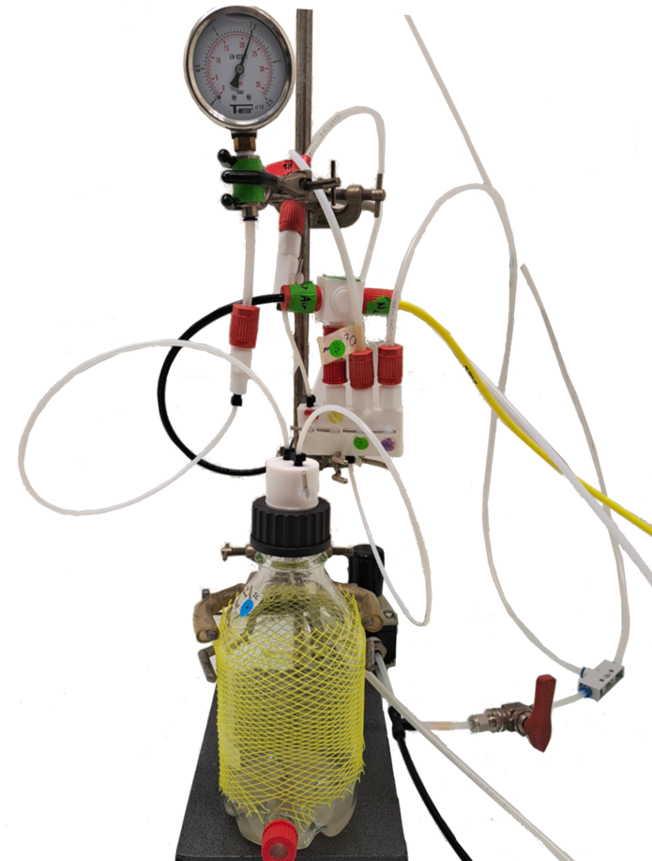
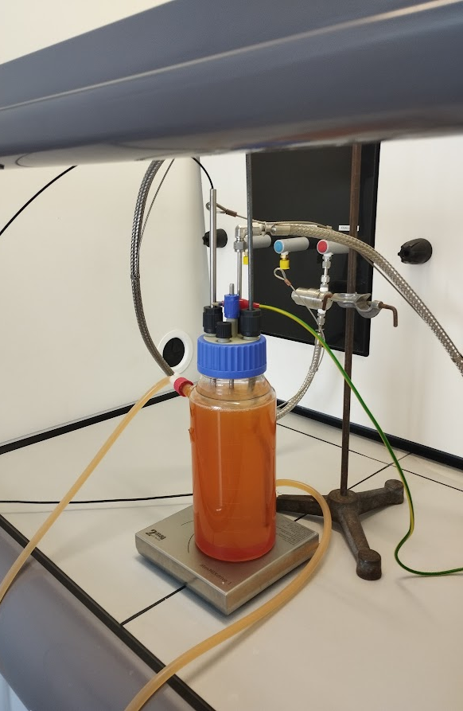
Small scale cultivation
Up to 1.5 bar overpressure
Cultivation in incubator
Gas composition customisable
Gases premixed (MFCs)
Connected to equipotential socket
Heated jacket and magnetic stirring
INSA, France
TU Graz, Austria
V_{work}= 1000 mL
V_{work}= 100 mL
Notes:
Bottle flasks for quick parallel cultivations, often used for strain characterization
The reactor is placed in a fume hood, this helps to dilute gas leaks (though leakage is usually avoided). The gases are premixed with mass flow controllers (MFCs) and then fed into the reactor. There is also an outlet for the used gases (exhaust). There is a H2 detector connected to a check valve (this helps to shutdown the gas supply when there is leakage). The magnetic stirrer and O2 sensor used are ATEX approved. The heating is by means of a water bath with a thermostat. The setup is connected to an equipotential socket, which balances electrical potential across the system and prevents the formation of sparks.

Slide 5
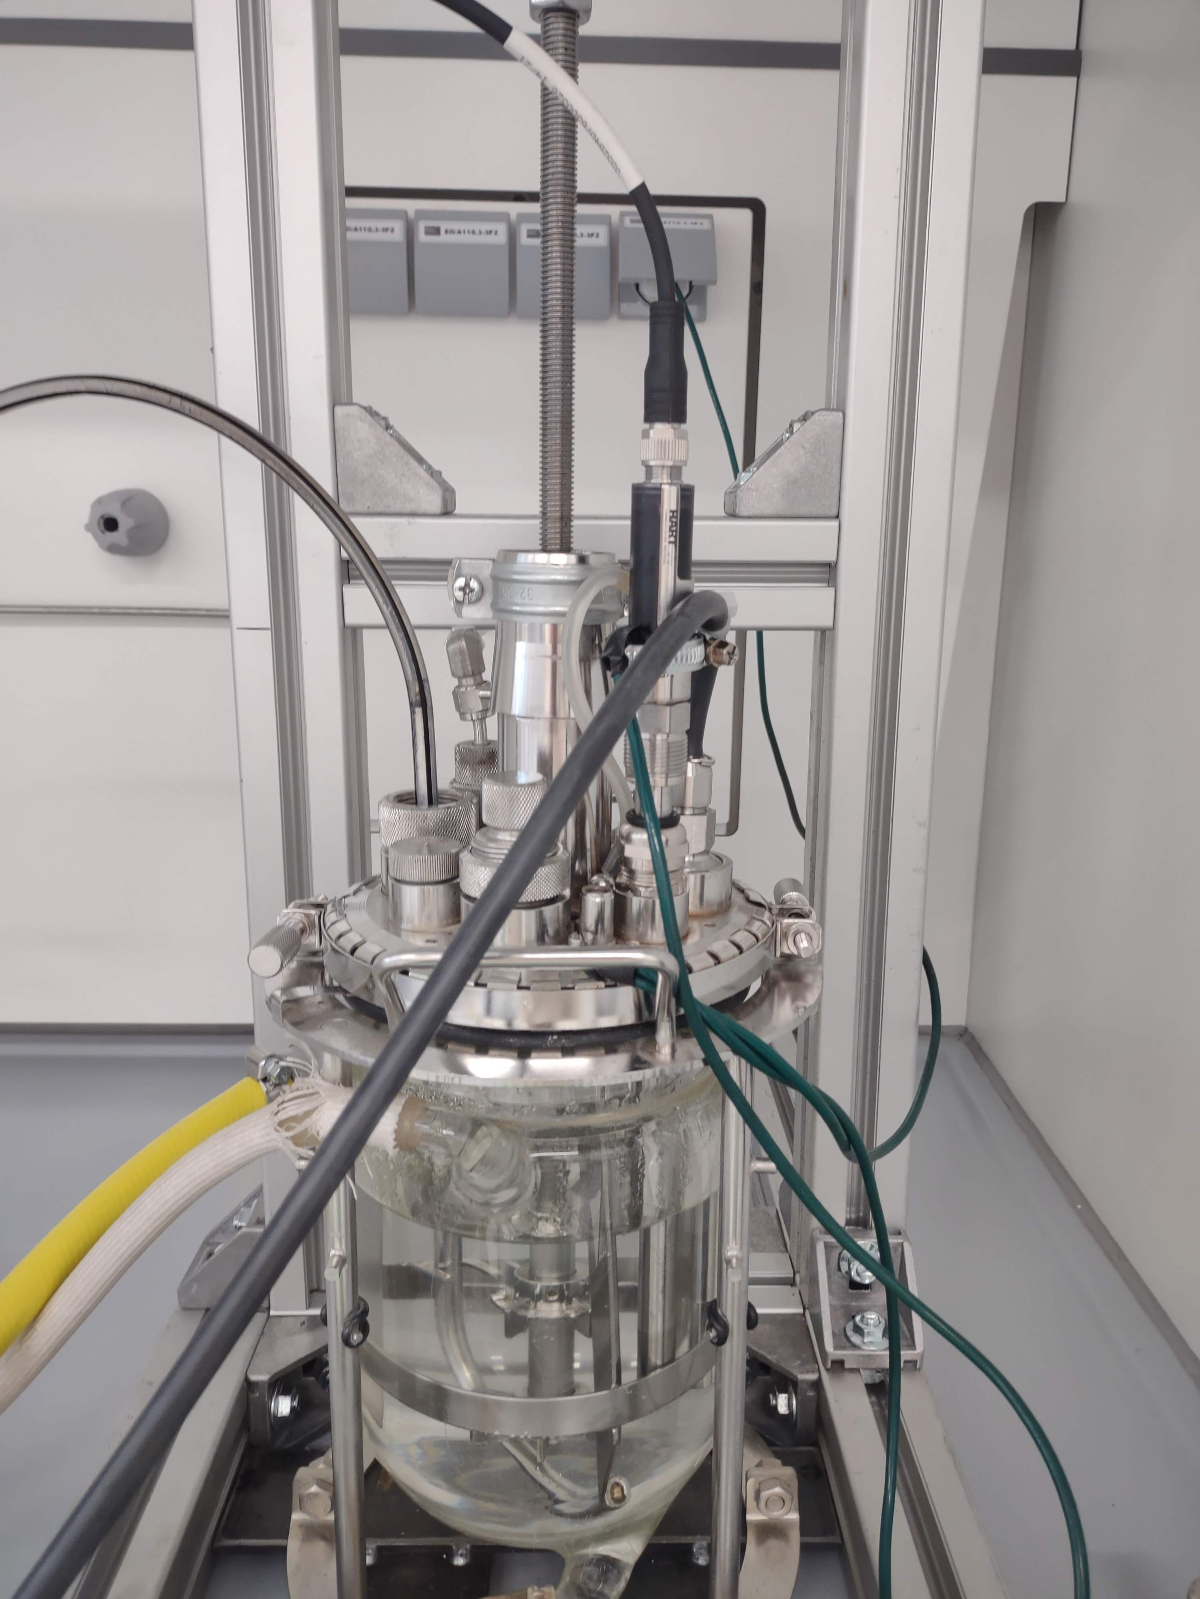
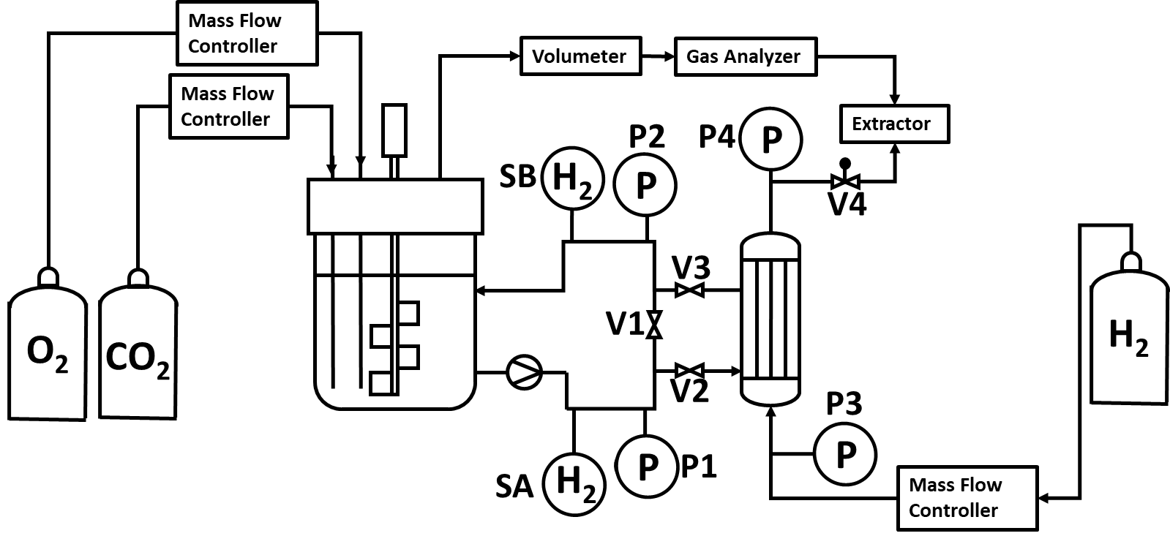
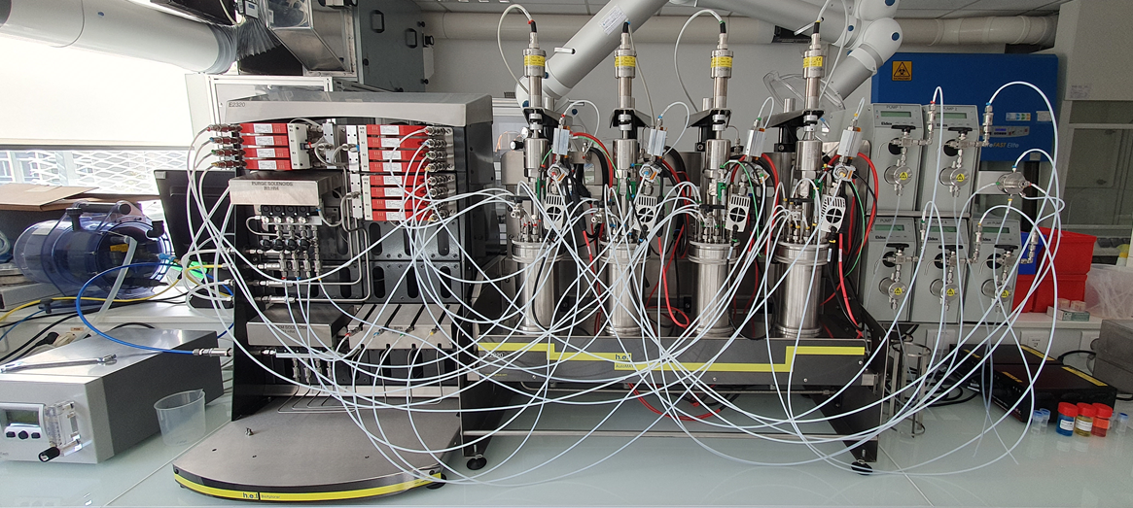
Lab-scale cultivation
dH₂ via membrane
V_{work} = 1.2 L
Gas premixed from MFCs
DO under 2%
Equipment following ATEX regulation
Silantes, Germany
TU Graz, Austria
Gas supplemented individually
Online analysis of gas in- and outflow
Up to 10 bar
N₂-flushing
TU Graz, Austria
INSA, France
TBI, France
Notes:
DO: Dissolved oxygen. MFCs: Mass flow controllers. The reactor is placed in a fume hood, this helps to dilute gas leaks (though leakage is usually avoided). The gases are premixed with mass flow controllers (MFCs) and then fed into the reactor. There is also an outlet for the used gases (exhaust). There is a H2 detector connected to a check valve (this helps to shutdown the gas supply when there is leakage). Stirring is by external motto, this helps to reduce ignition risks associated with conventional stirrers. The O2 sensor used is ATEX approved. The heating is by means of a water bath with a thermostat. The setup is connected to an equipotential socket, which balances electrical potential across the system and prevents the formation of sparks.

Slide 6
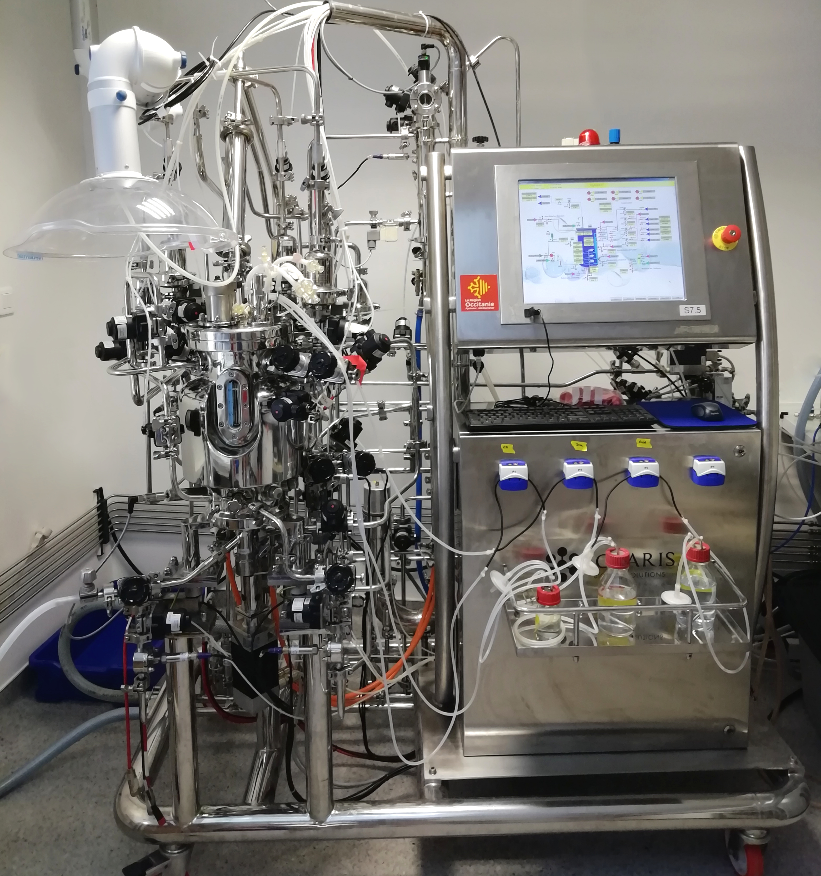
Lab-scale cultivation
V_{work} = 7.5 L
Gas supply via 3 independent spargers
Application of up to 3 bar
Limit headspace O₂ to < 4 % (explosion threshold) via N₂ -flushing
INSA, France
TBI, France

Slide 7
H₂ 4%
O₂ 6%
Cultivations at all scales
Safe and effective cultivations
Robust analytics and control
Reactor Development
Running gas fermentations at high cell densities and speeding up development bioprocesses from CO₂
Increasing robustness of processes
Robust bioprocesses
Robust strains
Reactor design
k_{L}a
Media
composition
Gas solubility
Notes:
Current bottlenecks are :
the difficulty to efficiently transfer gas at gas-liquid interfaces (resulting in limited cell densities)
the explosion risk associated with mixtures of hydrogen and oxygen above a critical concentration of 4% hydrogen and 6% of oxygen
the difficulties to provide robust and practicable analytics to control the gas supply
the uncertainty of robustness of engineered microbes in autotrophy

Slide 8
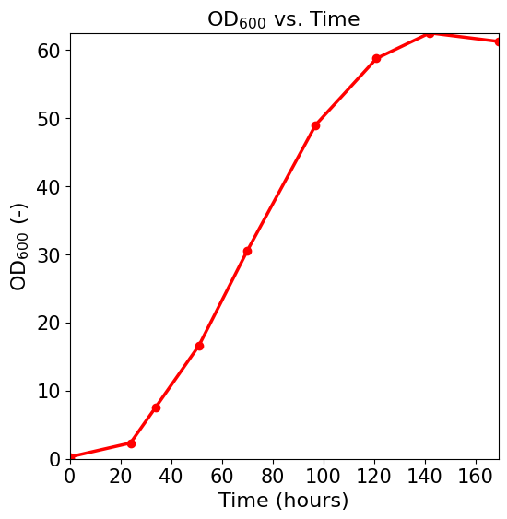
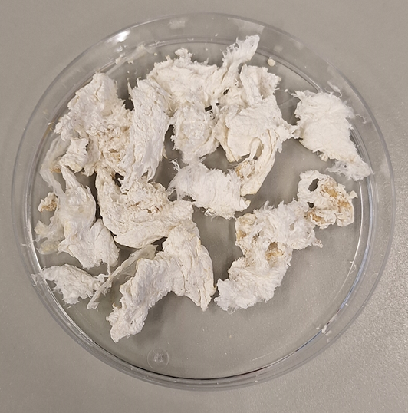
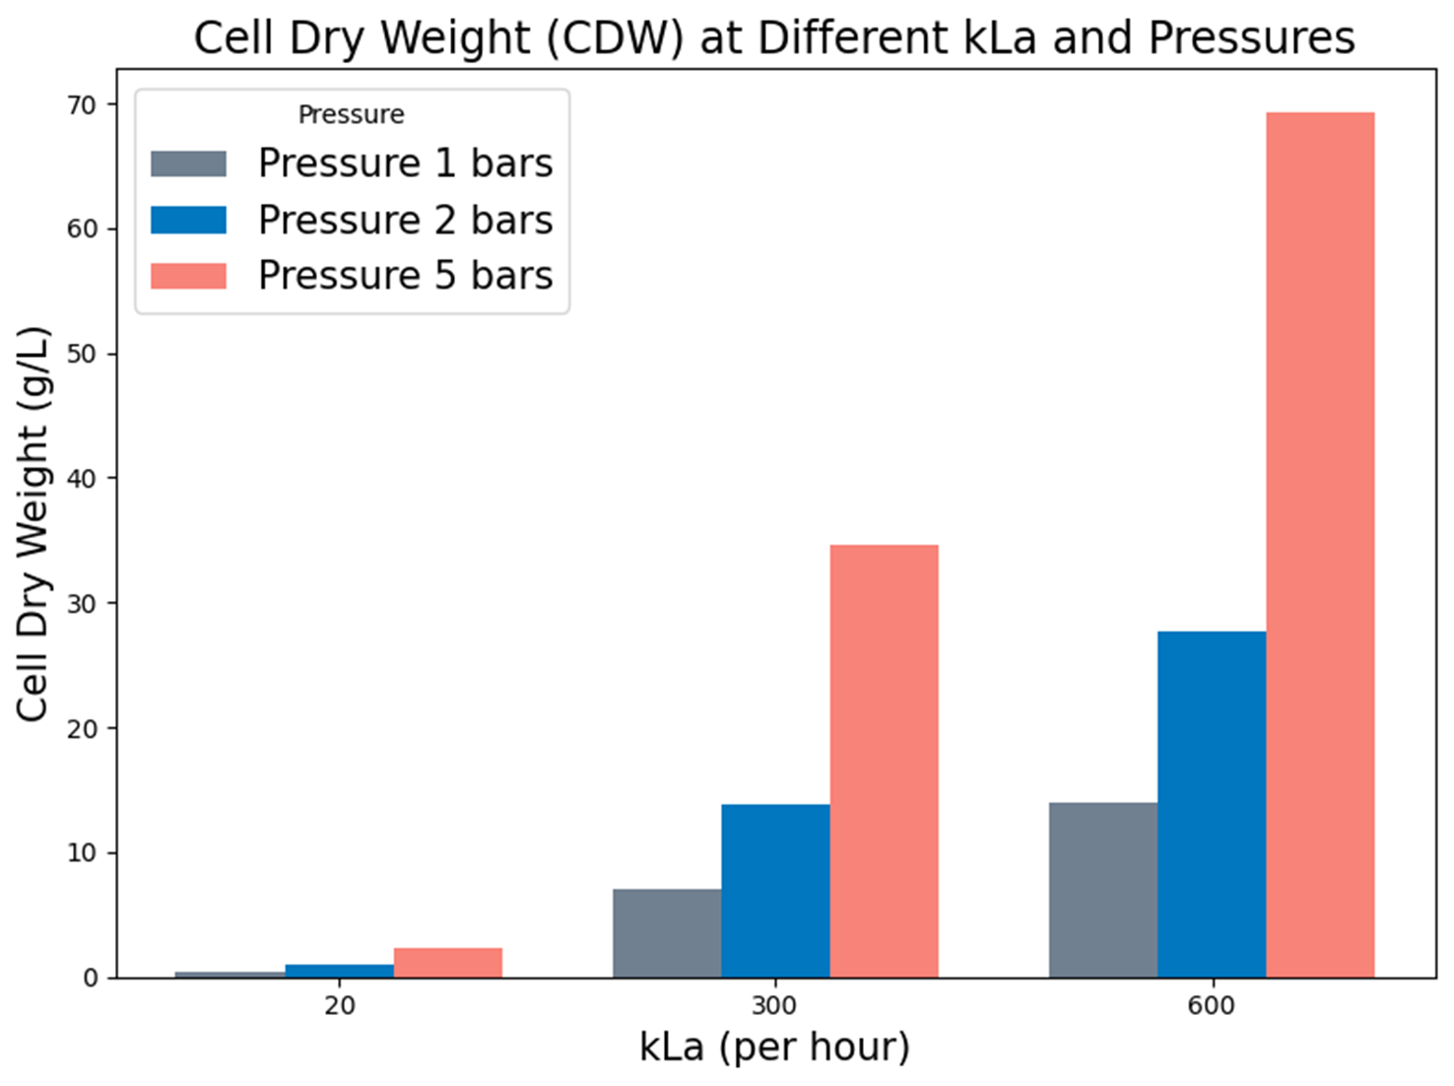




Gas fermentation matched to microbial requirements and technical feasibility
Strain characterization
Small and lab-scale cultivations
PHB
High cell density gas fermentation
Product isolation and characterization
Pilot scale plant design
Halima Aliyu Alhafiz
Supervision: Assoc.Prof. Regina Kratzer, Prof. Lars Lauterbach, Dr. Birgit Pitterman
Notes:
Strains: WT, WT Tanaka, UV irradiated: N inhibition studies, choses the best strain
Proceded thigh cell dens ferment on that: up to 42.5
Isolation of PHB
Cultivations on bottle to labscale reactor

Slide 9
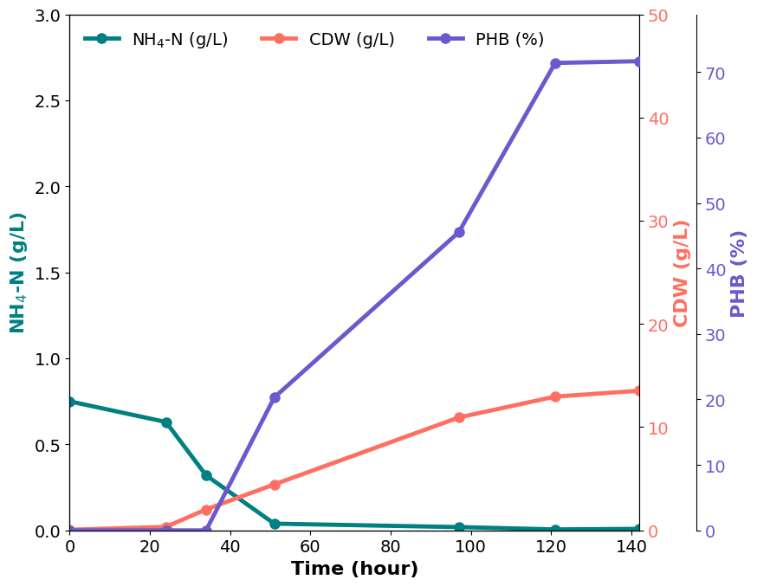

PHB production under non-explosive conditions
K_{L}a: 110 h⁻¹
CDW: 42.5 g/L
PHB: ~70%
C.necator DSM 545
H₂: O₂: CO₂ 40%: 2%: 5%
1.2 L bioreactor (887 rpm)
Tanaka et al., 1995
CDW 91.3 g/L & PHB ~ 68%
With K_{L}a = 2970 h⁻¹
[H₂: O₂: CO₂] 85.2%: 6.3%: 8.3%
Notes:
PHB accumulation starts when the nitrogen (in the form of NH4) is depleted.
My big why: Carrying out high cell density fermentation while balancing microbial requirements to technical feasibility
Trying to improve High-density fermentations despite low O2 to ensure safety
Best cultivation. In non-explosive conditions, cell density 42,5 gL, with a l mucg lower Kla than tanaka
Zeta she will do a scale up design

Slide 10
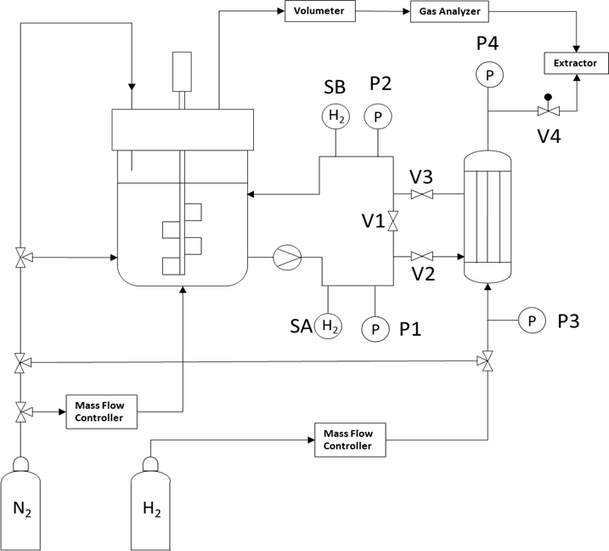
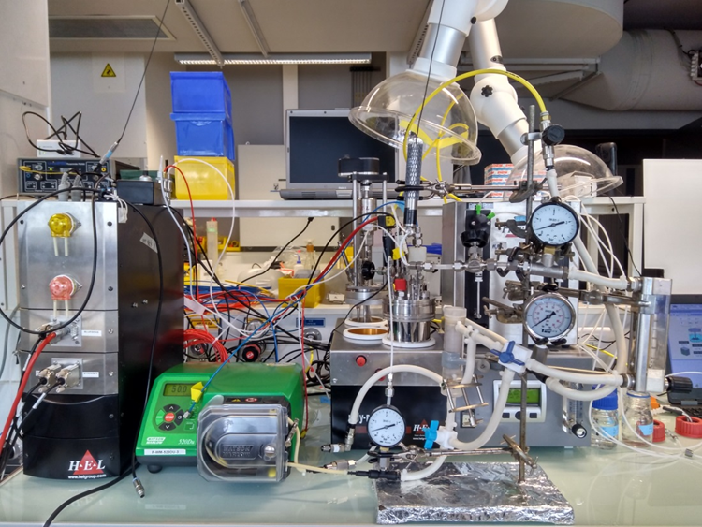



Impact of H₂ supply via membrane contactor on production of biomolecules from CO₂
Design of an effective system for membrane-based autotrophic cultivation without gas limitation (CO₂, H₂, O₂)
Designing fermentation strategy to drive IPA production performance by the H₂ transfer
Physiology studies for identifying potential stress linked to the use of HFMC
Federico Di Bisceglie
Supervision: Prof. Stéphane Guillouet, Assoc. Prof. Regina Kratzer, Olivier Lorain
Selection and characterization of Hollow Fiber Membrane Contactors (HFMC) in terms of H₂ transfer

Slide 11
Membrane supplementation of H₂
Production of isopropanol up to 1.4 g/L
Gaseous H₂ concentration reduced from the 65% measured before membrane connection down to 4%, the safety threshold for hydrogen
Proof of concept: safe fermentation at low H₂ atmosphere
Notes:
Avoiding H2 in the gas above 4% in gas to avoid explosion

Slide 12
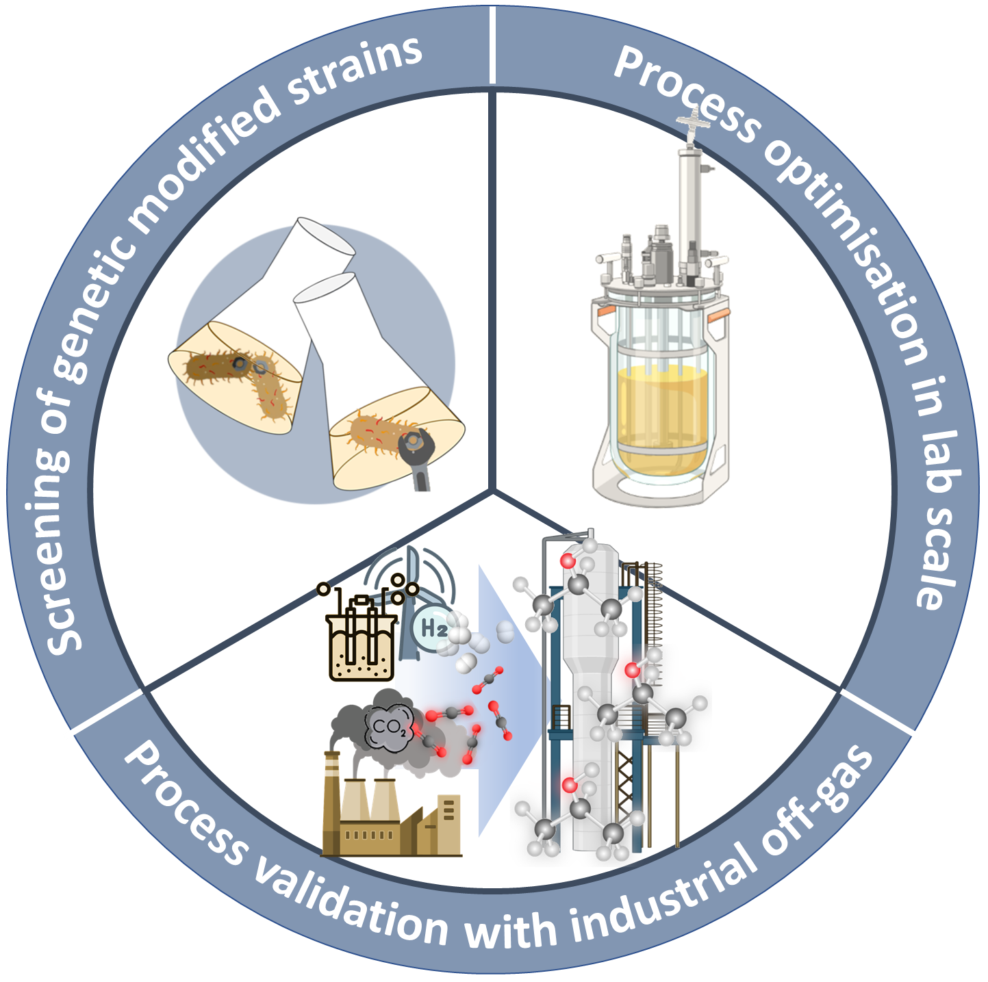


Efficient isopropanol production from CO₂
Development of autotrophic shake flask cultivation system
Implementation of online analysis for characterization of gas demand
Strain comparison
Identification of metabolic bottlenecks via proteome analysis
Medium optimisation
Isabell Weickardt
Supervision: Prof. Stéphane Guillouet,
Prof. Lars Blank, Celia Chenebault
Cultivation with
industrial off-gas
Notes:
-thesis of Isabell:
-setup of autotrophic shake flask cultivation system
-its adaptation for strain screening and medium optimization
-process optimization in bioreactor:
-implementation of online analysis to determine gas demands
-application omics to identify metabolic bottlenecks
-process validation with real industrial off-gas

Slide 13
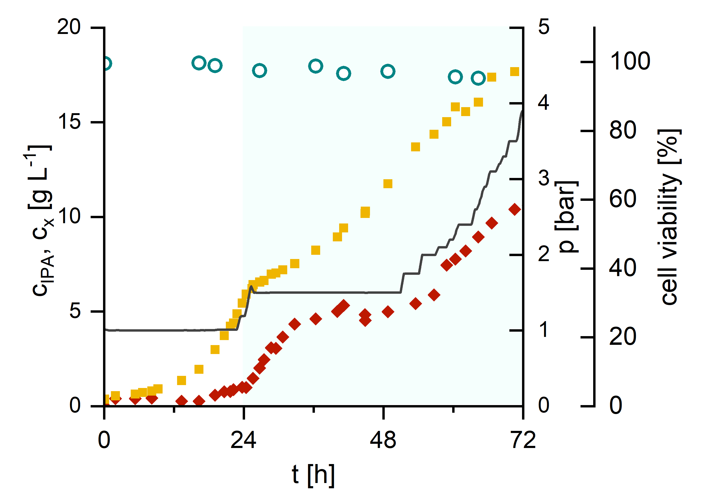
Autotrophic isopropanol formation on bioreactor scale
N-limited production phase
cell viability
Nitrogen limited product formation phase
Obtained 11 g L⁻¹ isopropanol (heterotrophy: 16 g L⁻¹ ^{[1]})
Cell membrane integrity stayed > 95 %
biomass
pressure
isopropanol
C. necator Re2133/pEG7c, 7.5 L fermenter, Q_{H2,max} = 60 L h⁻¹, Q_{air,max} = 90 L h⁻¹ , Q_{CO2,max} = 6.5 L h⁻¹
[1] Marc et al. 2017
Notes:
-Applying stepwise increased pressure up to 4 bar total pressure and an exponential feed for the product formation phase:
-(click) Obtained up to 17g/L biomass and 11 g/L IPA -> comparable to heterotrophic process with same strain which reached 16/L IPA
-despite the presence of the cell-toxic product and increases pressure the cellviability (click) stayed above 95 %, demonstrating the robustness of the cells

Slide 14

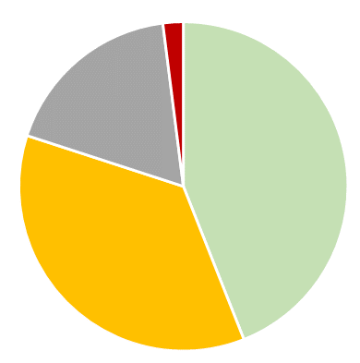
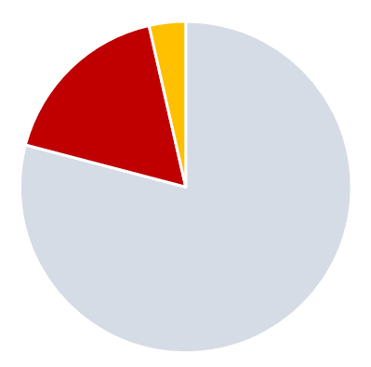
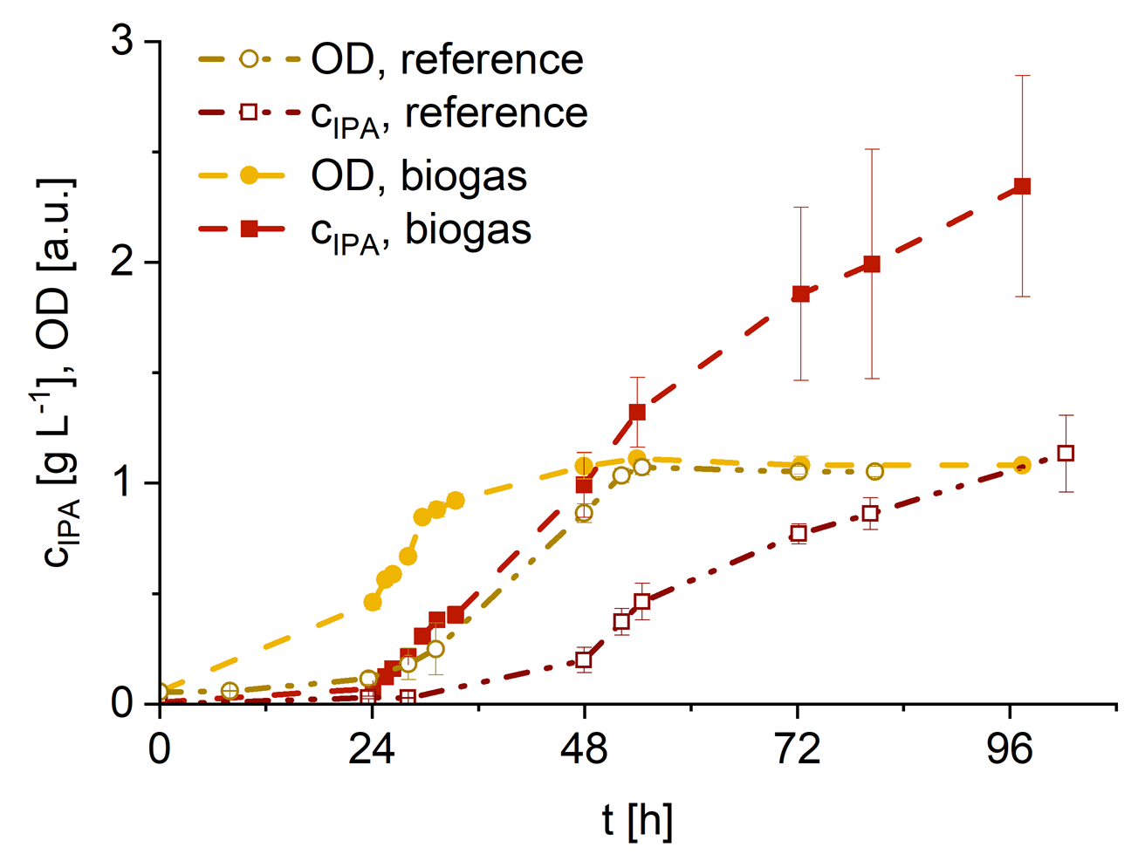
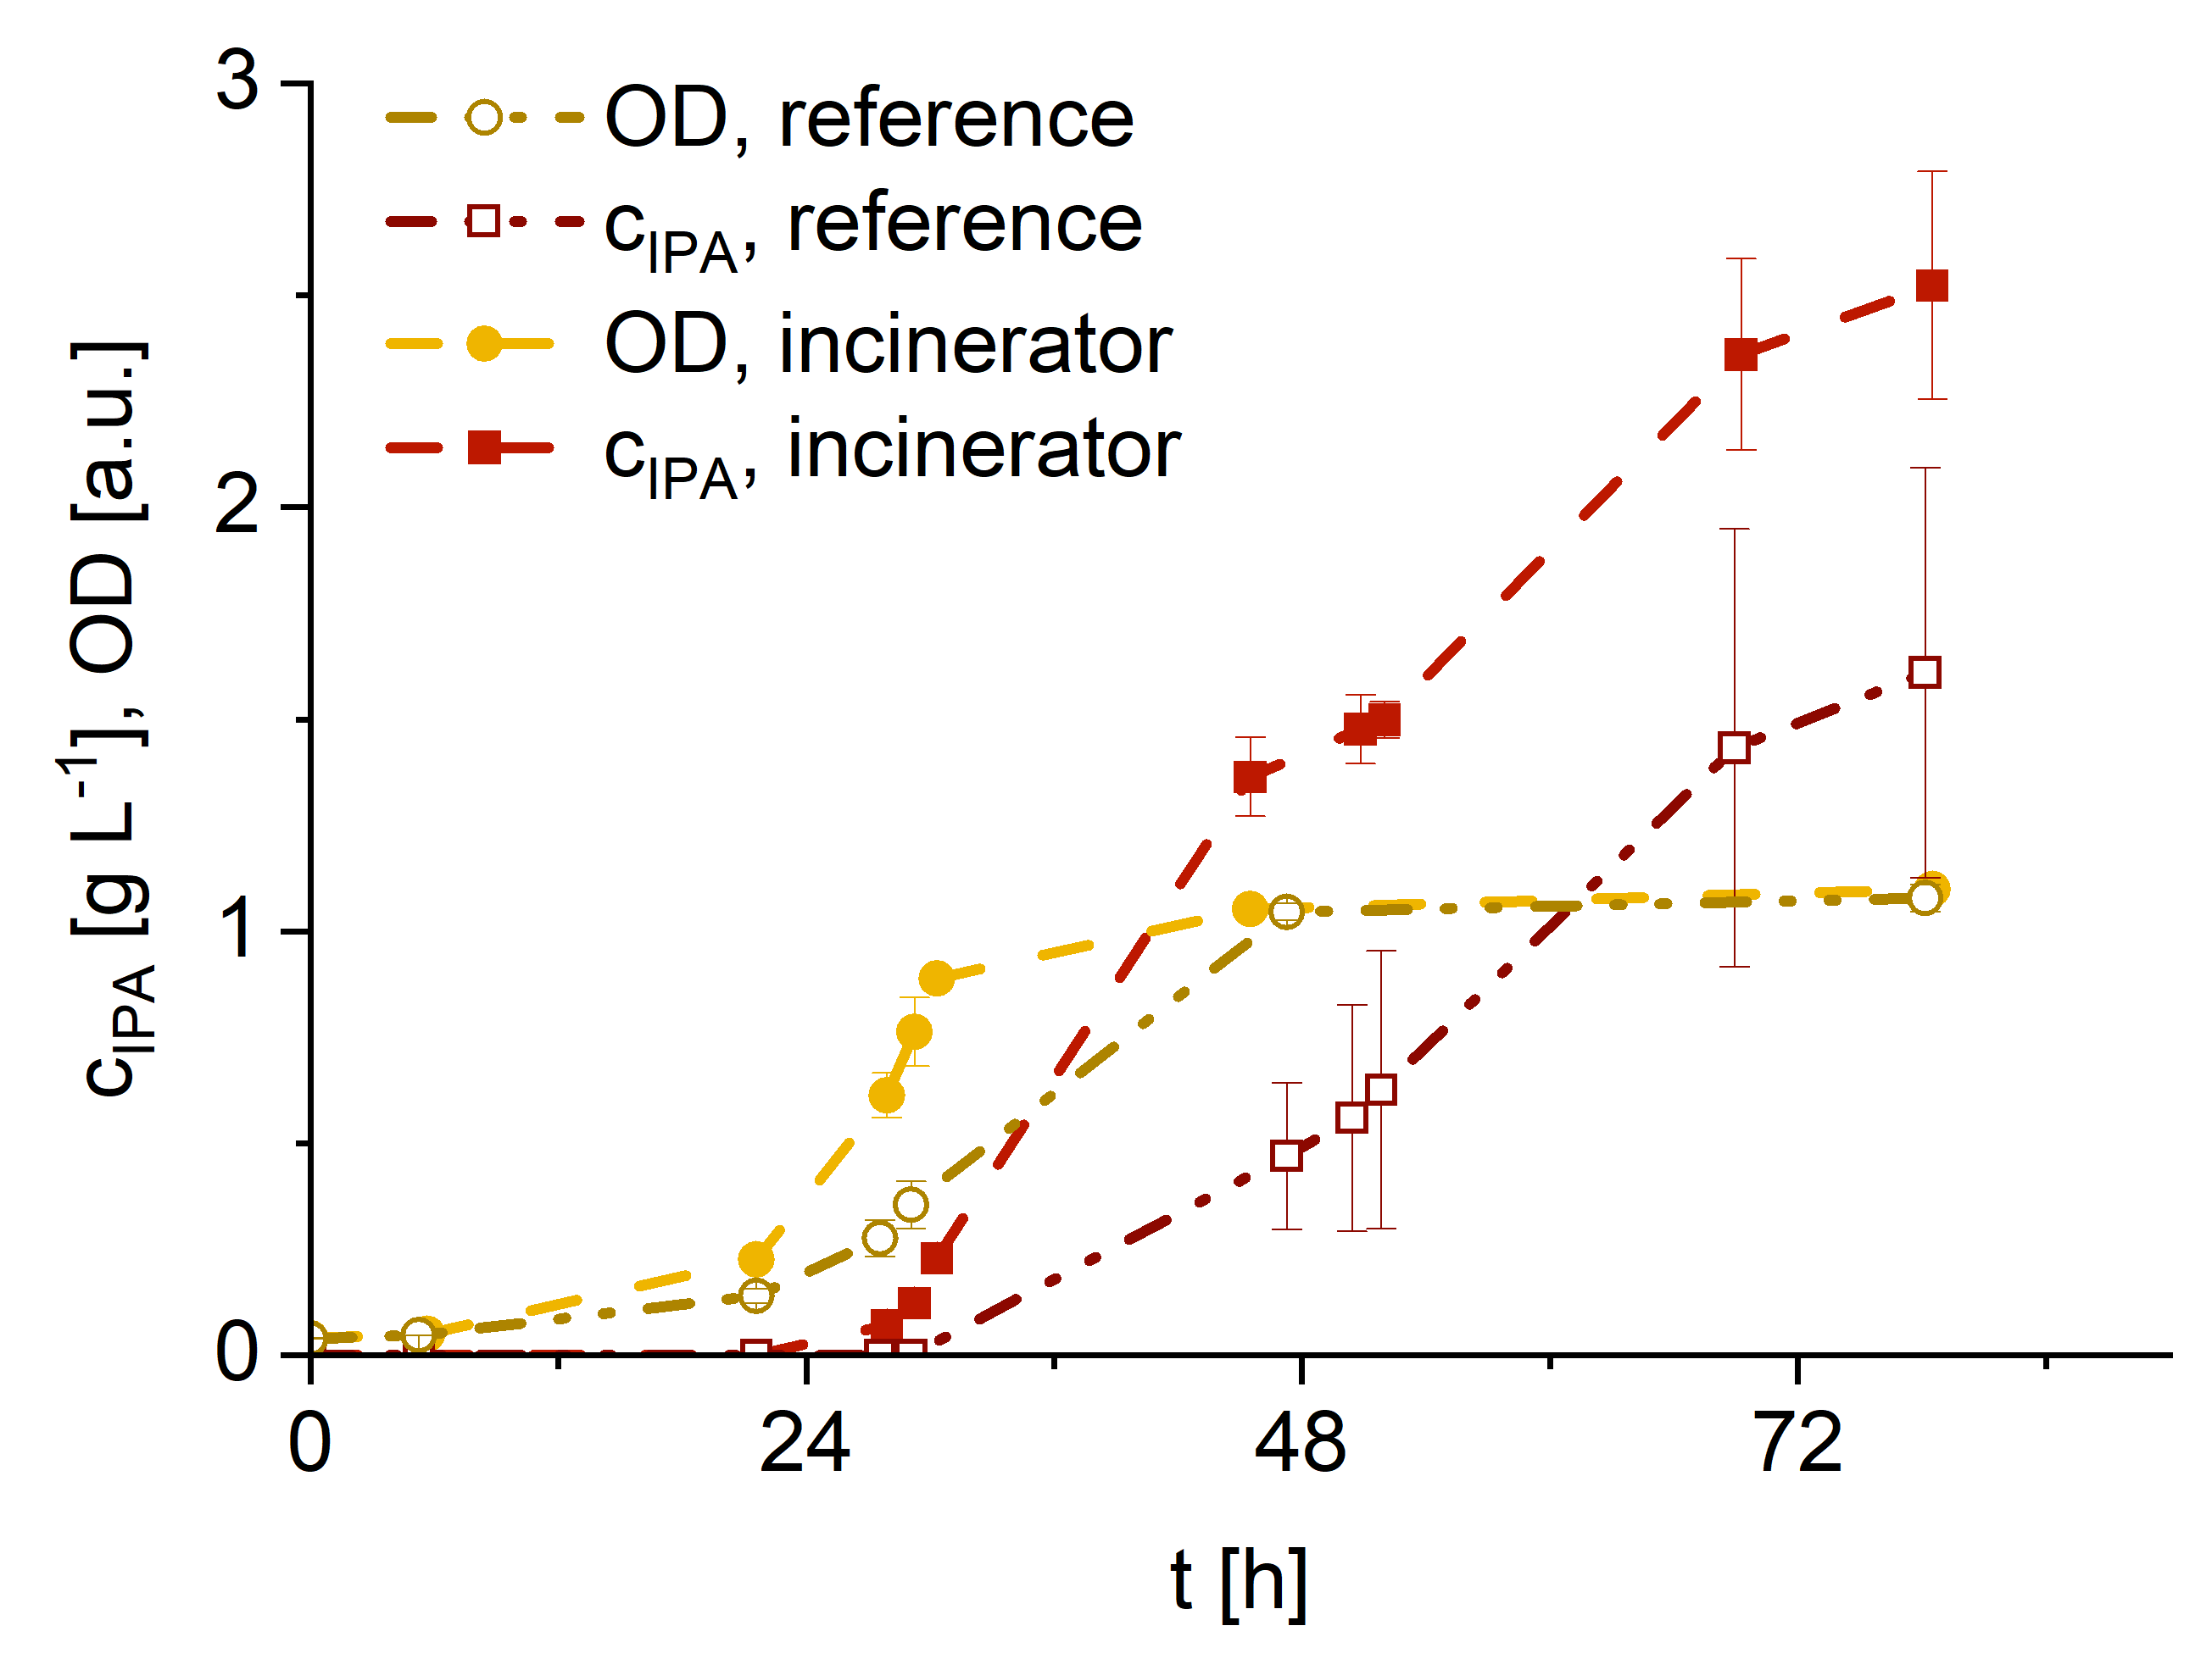
Process validation with industrial off-gas
O₂
CO₂
H₂O,
N₂
Impurities
200-750 ppm H₂S
10-20 ppm CO
120-130 ppm NO_{x}
O₂
Impurities
50-90 ppm NO_{x}
2 ppm CO
CH₄
Biogas
CO₂
N₂
Incinerator
IPA, incinerator
IPA, biogas
IPA, reference
IPA, reference
Industrial biogas: 40 % supplemented with 50 % H₂, 10 % O₂
Reference: 16 % CH₄, 12 % CO₂, 42 % H₂, 10 % O₂, 20 % N₂
Incinerator offgas: 70 % supplemented with 30 % H₂
Reference: 56 % N₂, 4 % CO₂, 30 % H₂, 10 % O₂
Notes:
The process was furthermore verified with real industrial off-gas on shake flask scale.
For this, the effluent of a biogas plant and an incinerator were used as a carbon source. Note here especially the present impurities in e.g. H2S and NOx [*point*]
In yellow [*point on the graph*] you can see the biomass concentration and in red the product formation
Compared to pure lab-gasses [*point on reference*] faster growth and higher final isopropanol concentration was observed when using real biogas which was quite surprising.
But the same was the case when using the incinerator offgas. Also here growth and product formation were improved with the incinerator off-gas compared to lab-grade gasses
2 diff gasses: biogas as CO2 source-> enrichment of methane for further valorisation, significant impurities
Incinerator: mostly nitrogen, fewer impurities, CO2 and O2 source at same time

Slide 15
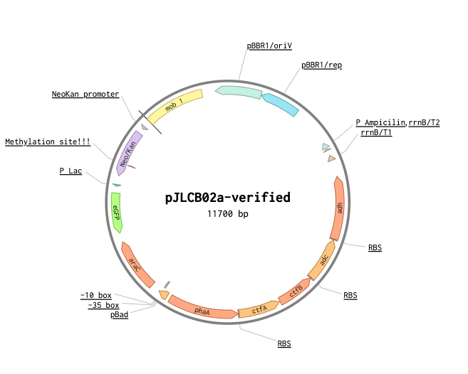


Assessing strain robustness of engineered C. necator
Pauline Pijpstra
Supervision: Dr. Nathalie Gorret, Prof. Robert Kourist, Dr. Petra Heidinger, Dr. Florence Mingardon

Slide 16
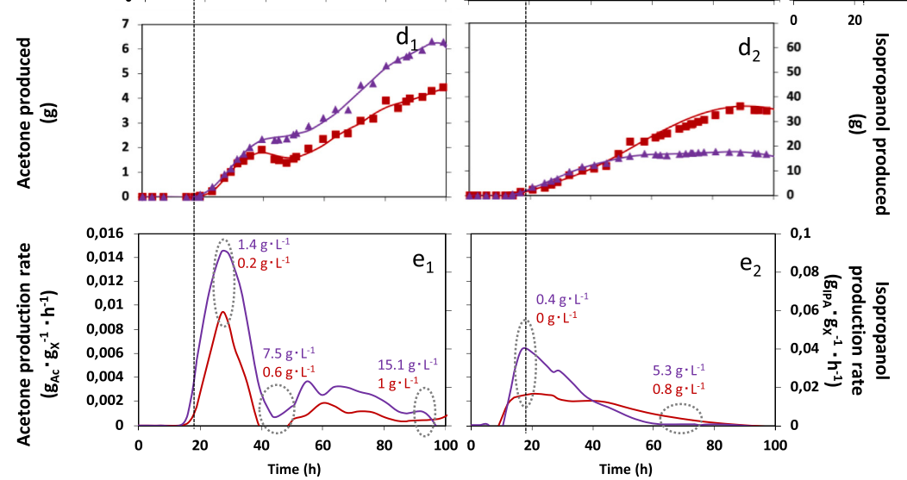
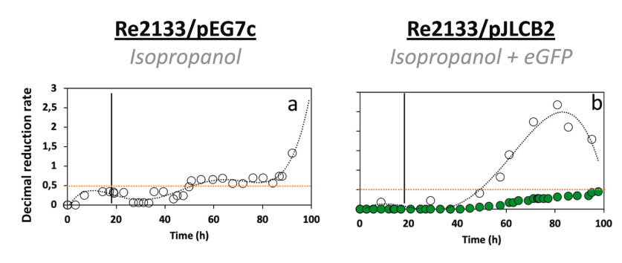
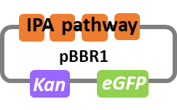
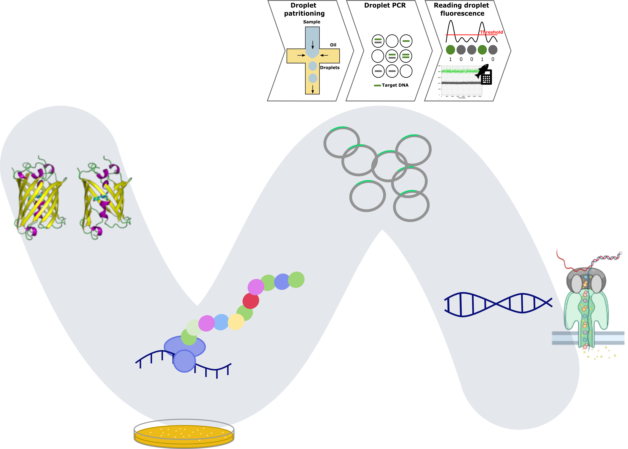
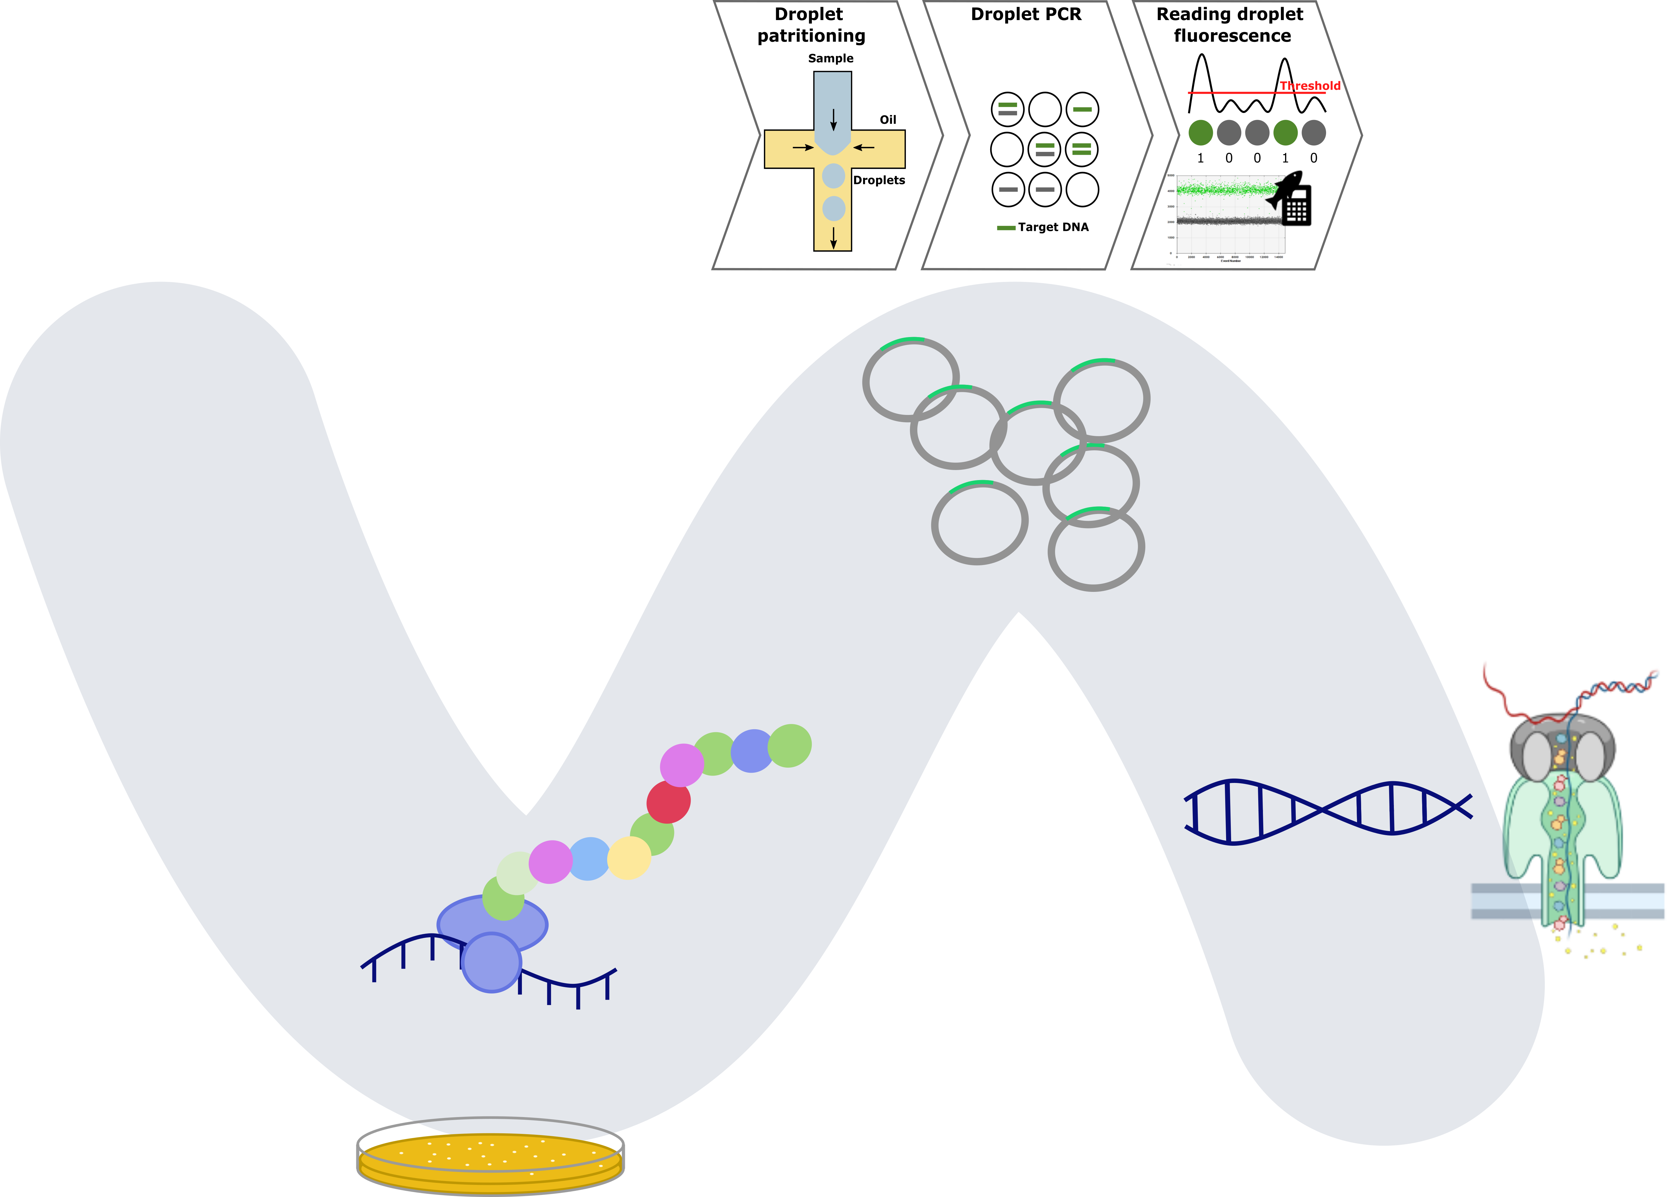
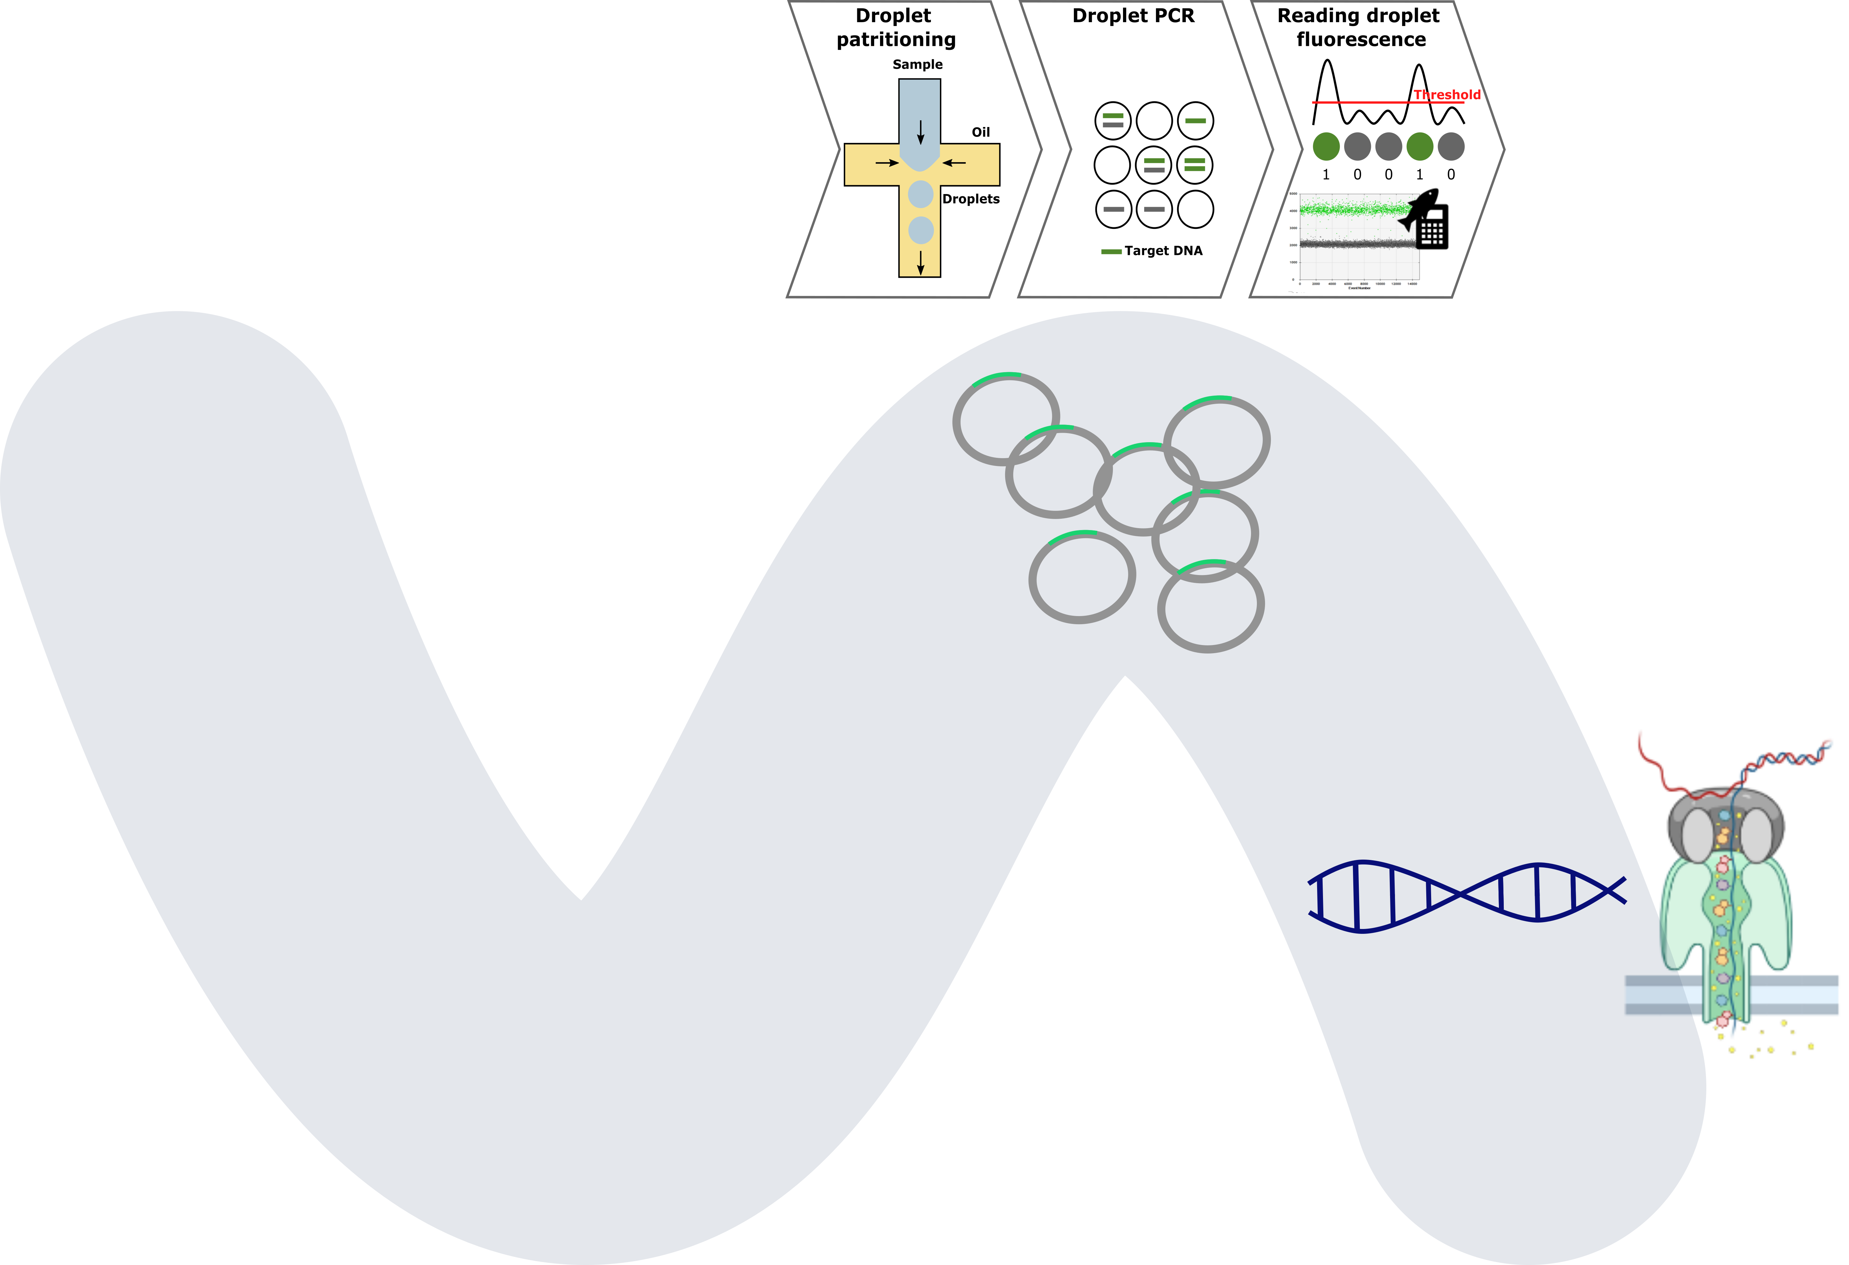
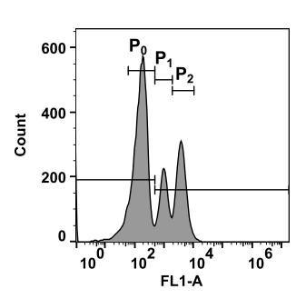
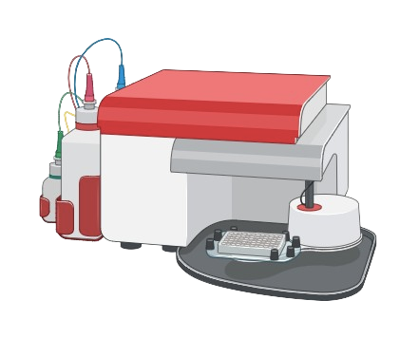

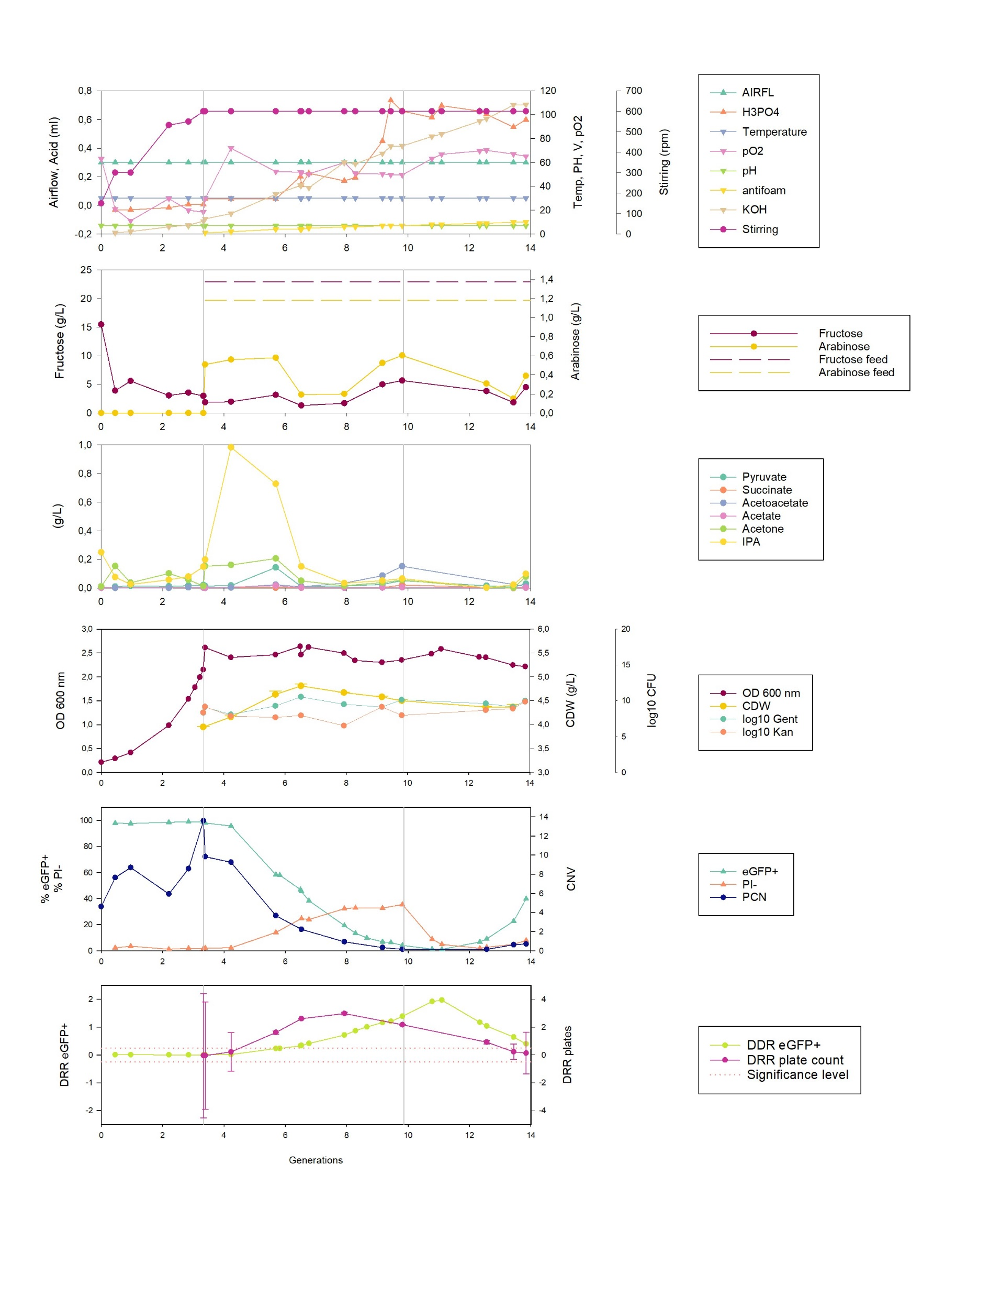

Assessing strain robustness
$$DRR=log\frac{eGFP+ + eGFP−}{{eGFP}^{+}}$$
*
*
Production rate decreases as fed-batch cultivation continues
Biosensor tested in fed-batch bioreactor culture
In continuous culture eGFP⁺ population is lost
Need for understanding population dynamics and their mechanisms
* Boy, C., Lesage, J., Alfenore, S., Guillouet, S. E. & Gorret, N. Co-expression of an isopropanol synthetic operon and eGFP to monitor the robustness of Cupriavidus necator during isopropanol production. Enzyme Microb. Technol. 161, (2022).

Slide 17

H₂ 4%
O₂ 4%
Cultivations at all scales
Safe and effective cultivations
Robust analytics and control
Reactor Development
Increasing robustness of processes
Robust bioprocesses
Robust strains
k_{L}a
Reactor design
Media
composition
Gas solubility
Notes:
It is safe and effective, feasible, interting, cool and awesome
MORE RESEARCH NEEDED, fund us please

Slide 18


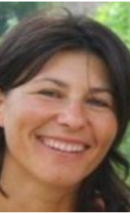



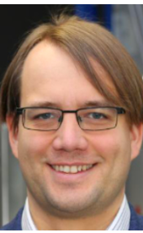
THANK YOU!
Prof. Dr. Stéphane Guillouet
Assoc. Prof. Dr. Regina Kratzer
Dr. Nathalie Gorret
Prof. Dr. Lars Blank
Prof. Dr. Lars Lauterbach
Dr. Petra Heidinger
Prof. Dr. Robert Kourist

Slide 19
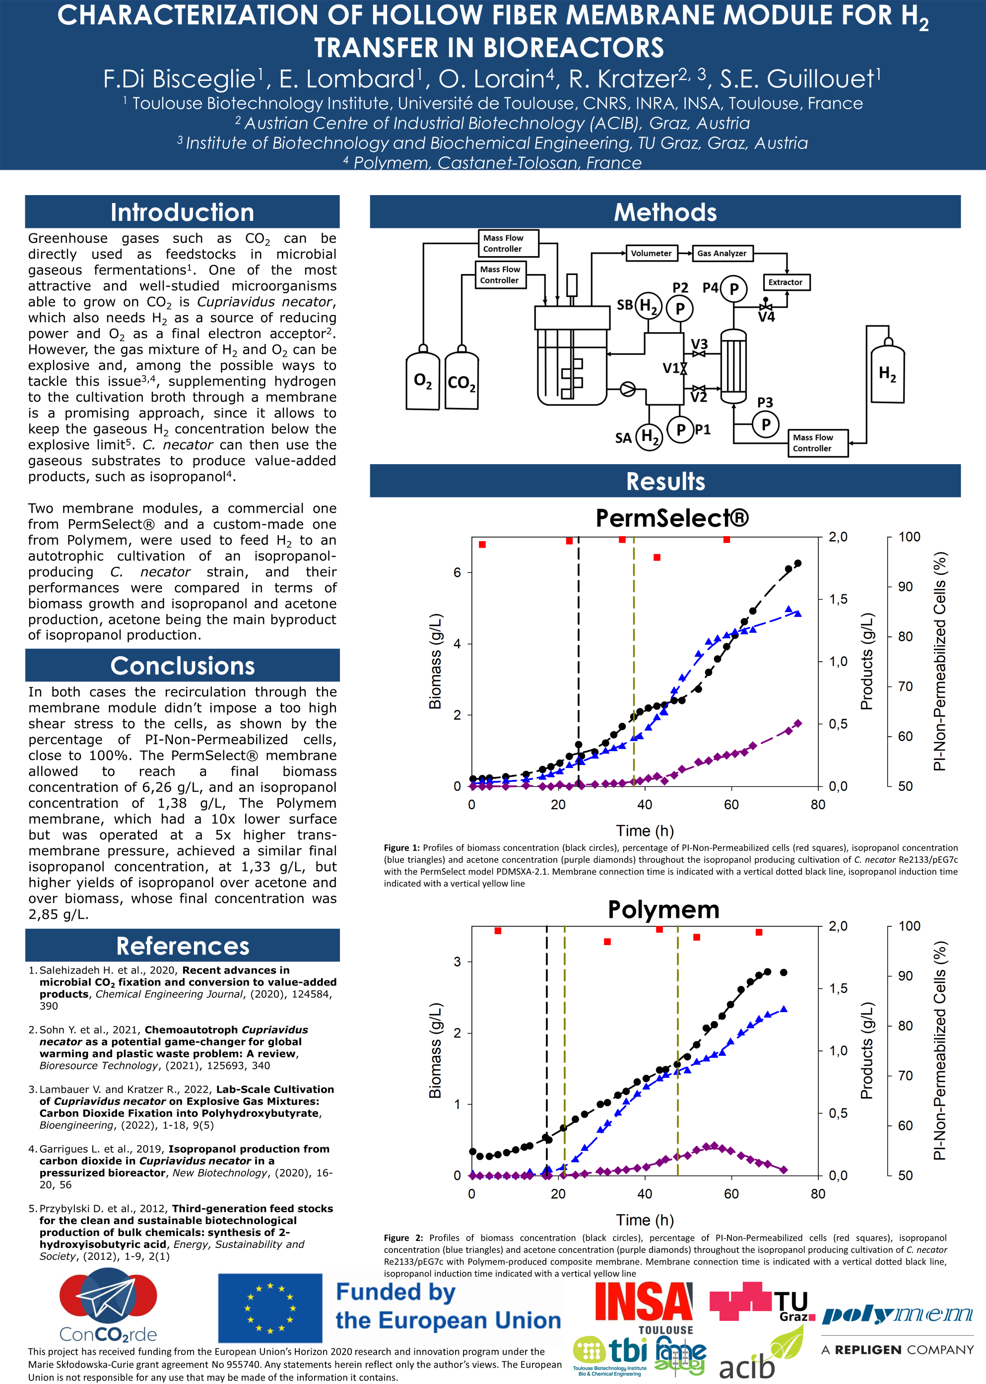
Federico Di Bisceglie
Federico Di Bisceglie
Supervision: Prof. Stéphane Guillouet, Prof. Regina Kratzer, Olivier Lorain

Slide 20
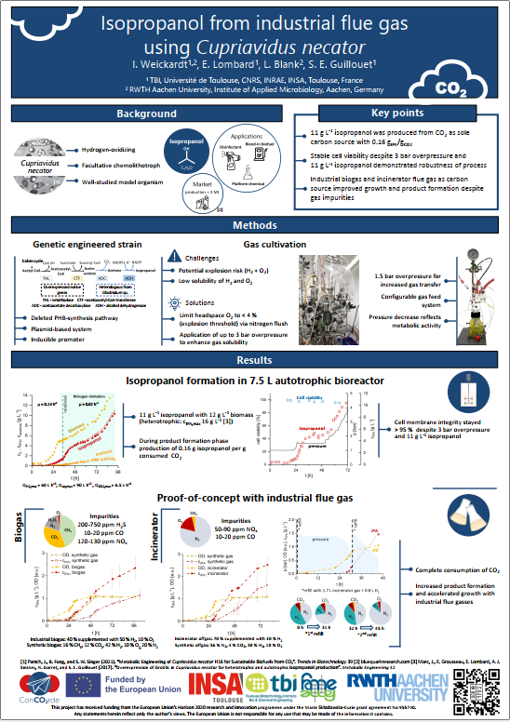
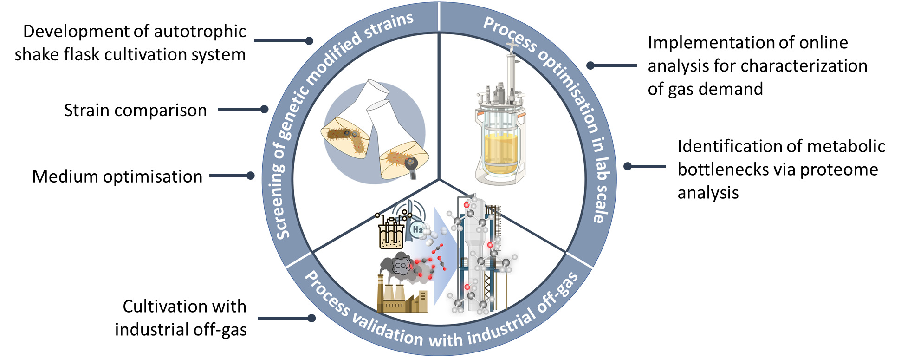
Isabell Weickardt
Notes:
Slide for 1 min poster pitch, might change again

Slide 21
Pauline Pijpstra
Supervision: Dr. Nathalie Gorret, Prof. Robert Kourist, Dr. Petra Heidinger, Dr. Florence Mingardon

Slide 22
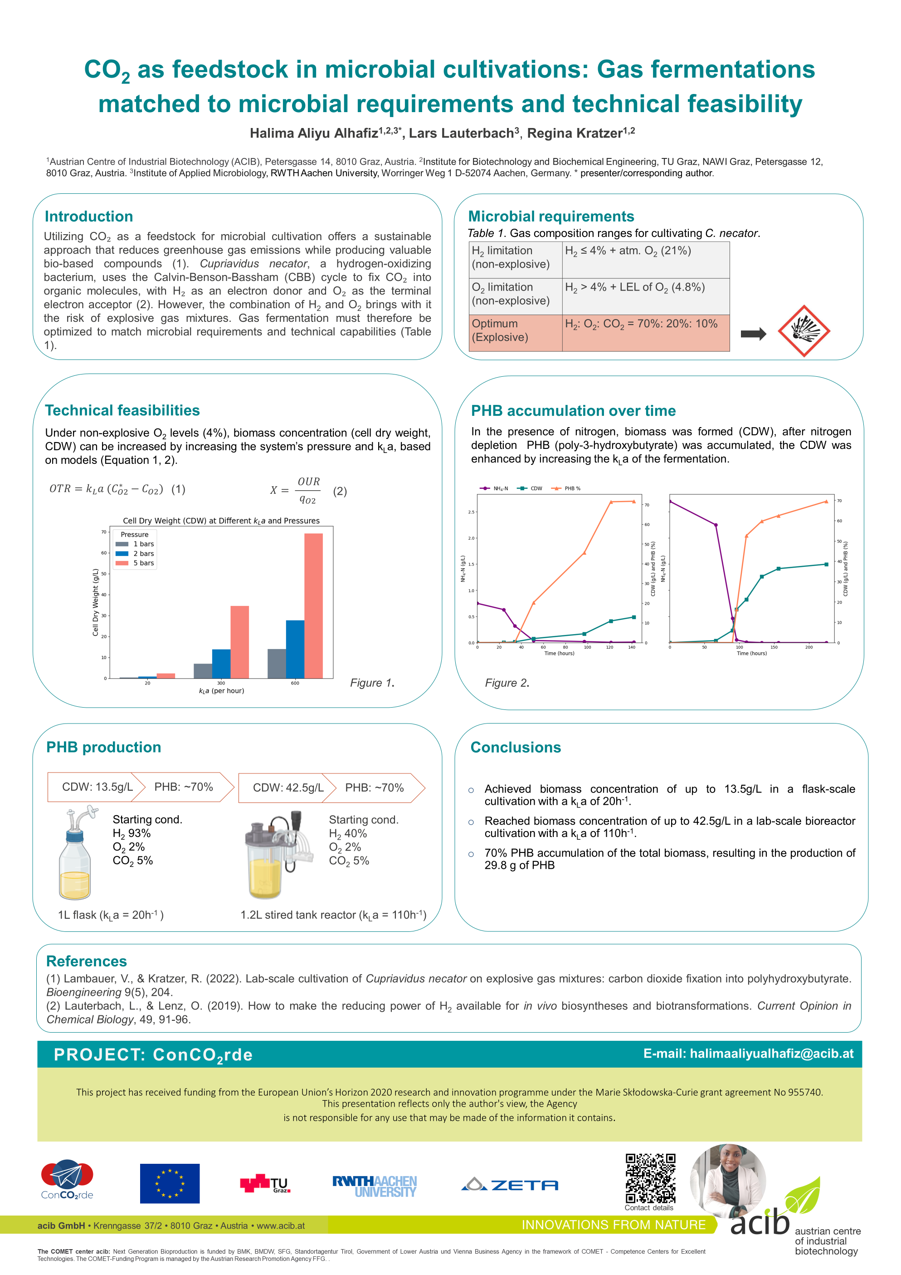
Halima Aliyu Alhafiz
Supervision: Assoc.Prof. Regina Kratzer, Prof. Lars Lauterbach, Dr. Birgit Pitterman

