Slide 1
Work Package 1: Chassis strain engineering for efficient gas feedstock conversion
esib 2024
ConCO₂rde Workshop
This project has received funding from the European Union’s Horizon 2020 research and innovation programme under the Marie Skłodowska-Curie grant agreement No 955740.
Notes:
Hi everybody, I’m Riccardo and today I have the pleasure to present you some of the results we achieved in three years in the ConCO2rde project.

Slide 2
Notes:
First of all, let’s see how the project was organised. It was divided in three work packages, each one focused on a different aspect of the development of the next generation of autotrophic biorefinery. In detail, WP1 was focused on the development of synthetic biology tools and metabolic engineering of the strain. WP2 was focused more on the development of hydrogen and electro-driven enzymatic cascades for the production of added-value compounds. And last but not least, the WP3 was focused on the reactor design and the improvement of the efficiency of the gas fermenattion process.

Slide 3
Notes:
In this presentation I will focus on what was done in WP1.

Slide 4
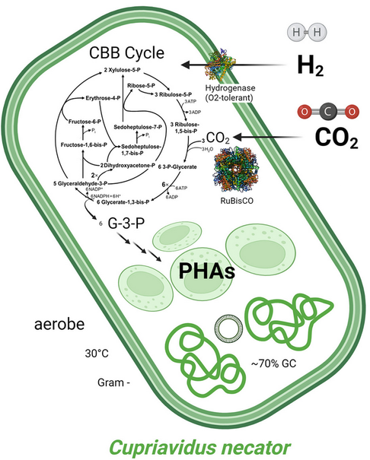
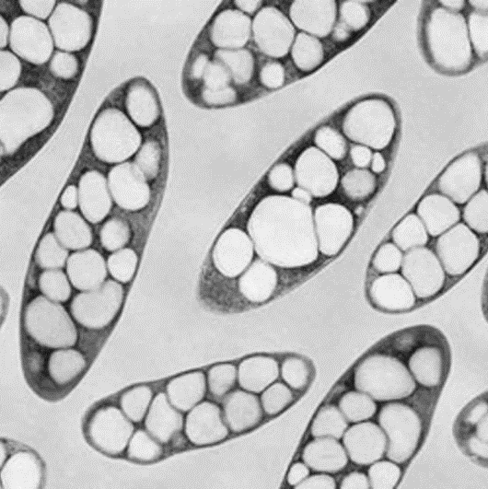
Cupriavidus necator H16
(Ralstonia eutropha H16 / Wautersia eutropha H16 / Alcaligenes eutrophus H16)
Native producer of PHB (polyhydroxybutyrate), > 70% biomass
Facultative chemolithotroph, Knallgas bacterium (CO₂/H₂/O₂)
Heterotrophic growth on defined or complex media
GRAS (studies for single cell protein)
Panich J, et al. Trends Biotechnol. 2021 Apr;39(4):412-424. doi: 10.1016/j.tibtech.2021.01.001
Pavan M., et al. Metabolic Engineering, 2022, ISSN 1096-7176, https://doi.org/10.1016/j.ymben.2022.01.015
Notes:
Of course I cannot proceed without first introducing you to the main protagonist of our story, Cupriavidus necator H16. Cupriavidus is a Gram-negative betaproteobacterium that was isolated from sludge in Gottingen, in Germany, in 1969. As you can see, as the mighty hero of the most epic story, it had been called with many names, you can see some here, before the scientific community came to an agreement on his current name. This created more than one problem at the beginning of our Phd when doing literature research. Cupriavidus has been extensively studied as a model organism for poly-hydroxibutirate synthesis, since it is able to accumulate the polymer up to 70% of its biomass in case of nutrient limiting conditions, for example, nitrogen or phosphate deficiency.
Another very interesting feature of the bacterium is its ability to be a facultative chemolitotroph, being able to grow on inorganic C1 compounds, formate for example, but also by using gas mixtures of Carbon dioxide, molecular hydrogen and oxygen. Moreover it has a very versatile metabolism that allows it to grow on a variety of different organic compounds. And on top of this is also non-pathogenic and regarded as GRAS.

Slide 5
Cupriavidus necator H16
(Ralstonia eutropha H16 / Wautersia eutropha H16 / Alcaligenes eutrophus H16)
Native producer of PHB (polyhydroxybutyrate), > 70% biomass
Facultative chemolithotroph, Knallgas bacterium (CO₂/H₂/O₂)
Heterotrophic growth on defined or complex media
GRAS (studies for single cell protein)
Complex genetics
4.1 Mb chromosome
High %GC content: 66%
2.9 Mb chromid
High plasmid loss and recombination
0.4 Mb megaplasmid
Panich J, et al. Trends Biotechnol. 2021 Apr;39(4):412-424. doi: 10.1016/j.tibtech.2021.01.001
Pavan M., et al. Metabolic Engineering, 2022, ISSN 1096-7176, https://doi.org/10.1016/j.ymben.2022.01.015
Notes:
All these features makes it appealing as a microbial cell factory, but we have to take into account the complex genetics of this organism, since it is equipped with a big chromosome, a slightly smaller chromid and a megaplasmid that contains most of the genes required for autotrohic growth. Notably, it also has a high GC content and it shows high plasmid loss and high frequency of recombination events.

Slide 6
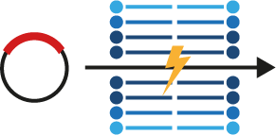
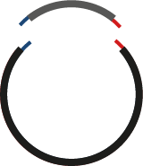
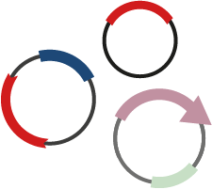
Transformation is mostly performed by conjugation, especially for large expression plasmids and suicide plasmids
Genome engineering mostly relies on double homologous recombination
No easy cloning pipeline
Protein expression strongly depends on the protein and is not predictable
Notes:
We identified 4 main bottlenecks in C. necator genetic engineering pipeline. Transformation is still mainly performed by conjugation, especially for large expression plasmids and and suicide plasmids. Genome engineering still relies on double homologous recombination events, which in some cases can be tricky to achieve. There’s no easy cloning pipeline established, and protein expression strongly relies on the protein expressed.

Slide 7
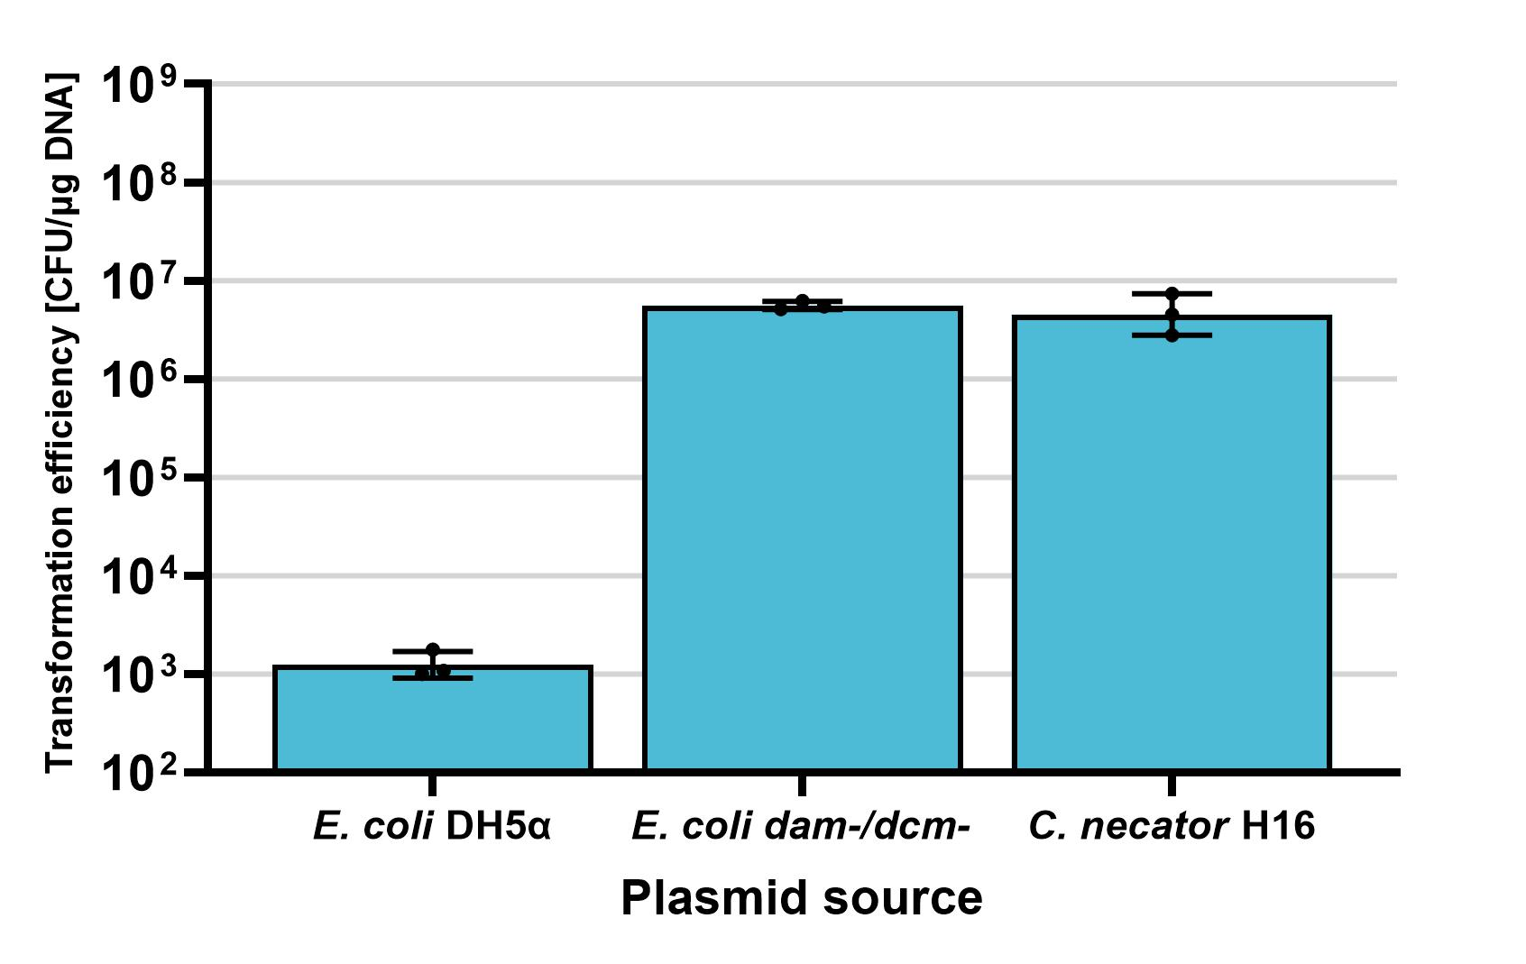
Two restriction-modification systems were identified
Type I restriction system
presence of the recognition pattern decreases efficiency 5000-fold
Type IV restriction system
using de-methylated DNA completely recovered electroporation efficiency
Both predicted systems were then deleted
Notes:
We first decided to tackle the electroporation problem. While DNA can be delivered via conjugation, the throughput compared to electroporation is lower since colonies need to be re-streaked to purity every time. We used bioinformatic algorithms and databases to predict the defense systems present in C. necator, and identified two restriction systems. A type I restriction system was able to decrease efficiency 5000-fold when one copy of the restriction pattern was present. There was also a type IV system able to degrade wrongly methylated DNA, but the efficiency was recovered when transforming de-methylated DNA. These two systems, as well as a third defense system, were deleted in order to create a domesticated strain.

Slide 8
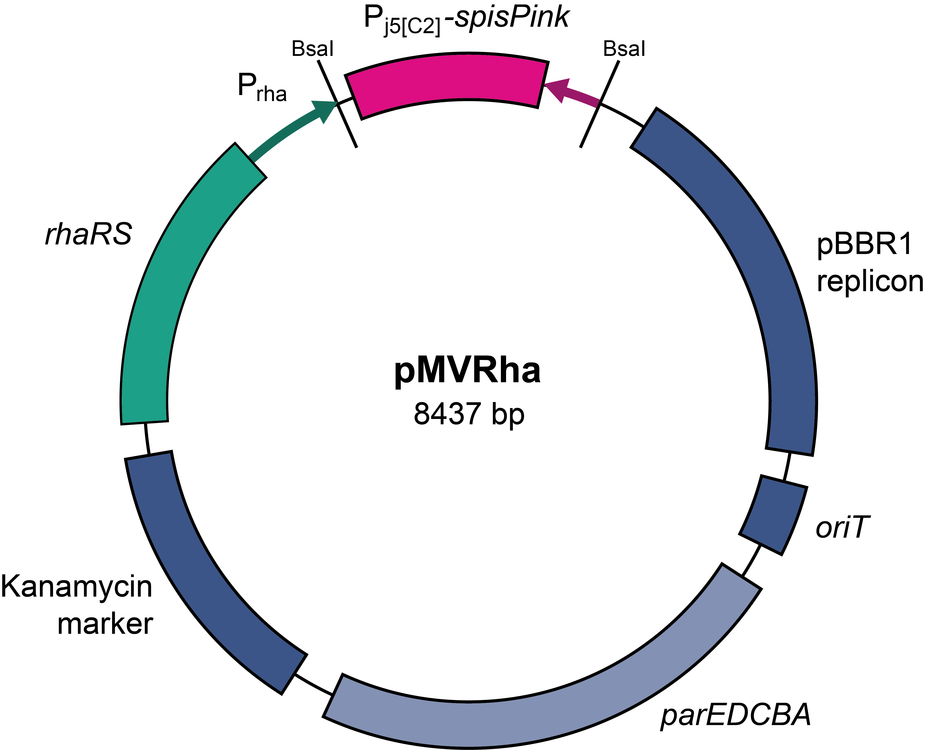
pMVRha
Golden Gate compatible
MoClo compatible
GOI is cloned under the control of an inducible promoter (rhamnose)
Pink-white cloning screening
From template to protein expression in C. necator H16 in < 2 weeks
Notes:
To improve cloning and ease of protein expression we assembled a pBBR1 based plasmid which can be cloned using BsaI (Golden Gate). The overhangs are compatible with the MoClo standard, and the gene of interest is directly cloned under the control of a rhamnose inducible promoter, which is tight and can be tuned using different concentration of rhamnose. The plasmid also contain a gene producing the pink protein spisPink, which is excised after cloning, and can be used as a cloning screening. This improved cloning speed drastically, and we can now clone, electroporate and express proteins in C. necator in less than two weeks.

Slide 9
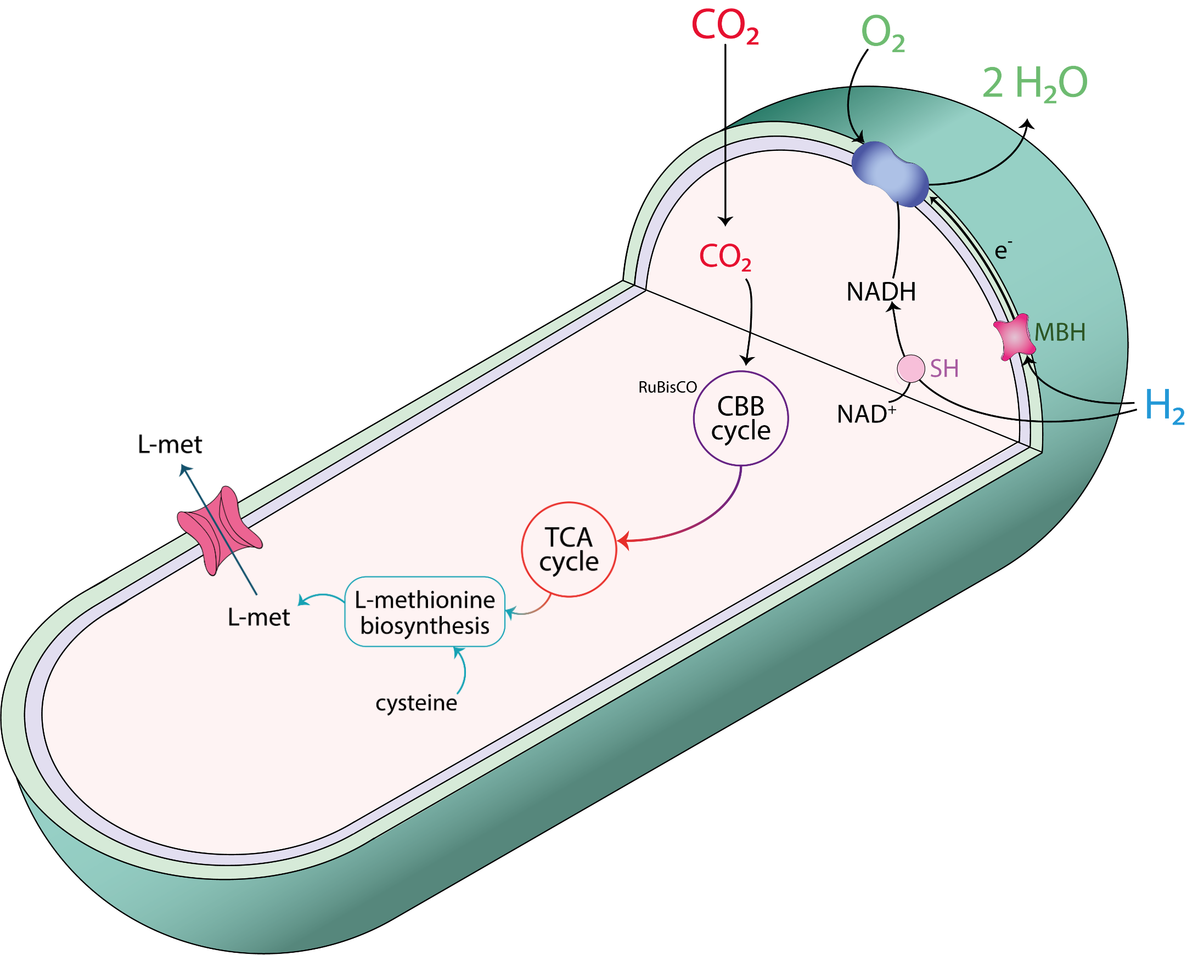
Overproduction of L-methionine in C. necator H16
Production under autotrophic conditions
Synthesis of isotope-labelled L-methionine
L-met = L-methionine
SH = soluble hydrogenase
MBH = membrane bound hydrogenase
RuBisCO = Ribulose-1,5-bisphosphate carboxylase/oxygenase
Notes:
Now let’s talk about some projects in which we used the developed genetic tools to engineer cupriavidus for the production of value-added compounds.
One of the projects focused on the overproduction of L-methionine in autotrophic conditions and, once achieved, the production of isotope-labelled L-met in collaboration with the industrial project partner Silantes .
L-methionine has a complex biosynthetic pathway regulated by negative feedback mechanisms that are activated when the intracellular concentration increases.

Slide 10
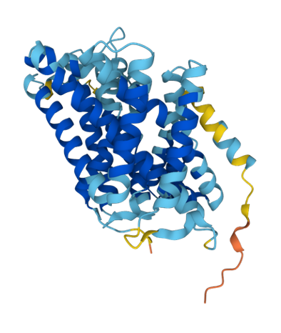
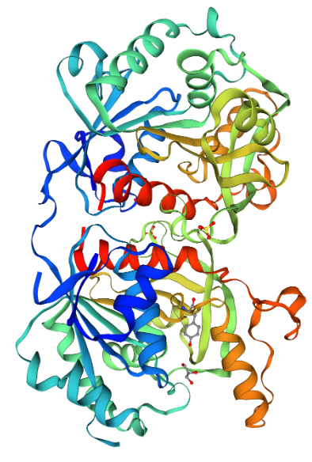
Increase the efflux of L-methionine from the cell
YjeH: efflux transporter for L-methionine
YjeH
Decrease the influx of L-methionine into the cell
MetD: high-affinity influx transport system for L-methionine
Increase the production of L-methionine
Expression of the homoserine O-succinyltransferase MetA
MetA
Notes:
Three main strategies were adopted:
Increase the efflux to avoid negative feedback and decreased production of L-met as a consequence
For this, the efflux transporter YjeH from E. coli K-12 was cloned in cupriavidus. This is an ATP independent transporter for branched chain amminoacid.
Decrease the influx of L-met into the cell
Avoid that produced L-met that has already been transported out of the cell is entering again
MetD is the high-affinity influx system for L-met in C. necator
Increase the production of L-met directly
Expression of MetA, a homoserine O-succinyltransferase from E. coli K-12
It is the main pacemaker enzyme‘ of the biosynthetic pathway

Slide 11
C. necator ∆MetD YjeH (from E. coli K-12)
Increased efflux and decreased influx of L- methionine
Production of L-methionine in autotrophic conditions
C. necator MetA (from E. coli K-12)
Increased L-methionine production in heterotrophic conditions
Notes:
Generation of C. necator ∆MetD YjeH:
MetD is knocked out (pLO3), YjeH is inserted into the genome under the control of a constitutive promoter
This strain was confirmed to produce L-met in small amounts under autotrophic conditions
Under heterotrophic conditions, C. necator with a plasmid with the MetA gene on it (and an inducible promoter), produces L-methionine
Expression of MetA in the C. necator ∆MetD YjeH strain has to be tested to show the potential effect of YjeH (if present)
Production of the transporter after plasmid-based expression could not be confirmed (His-tagged protein)
New stregy: prove the effect of the transporter, not the presence
Indication that C. necator ∆MetD YjeH produces L-met in small amounts under autotrophic conditions
Finding has to be confirmed and more experiments have to be done

Slide 12
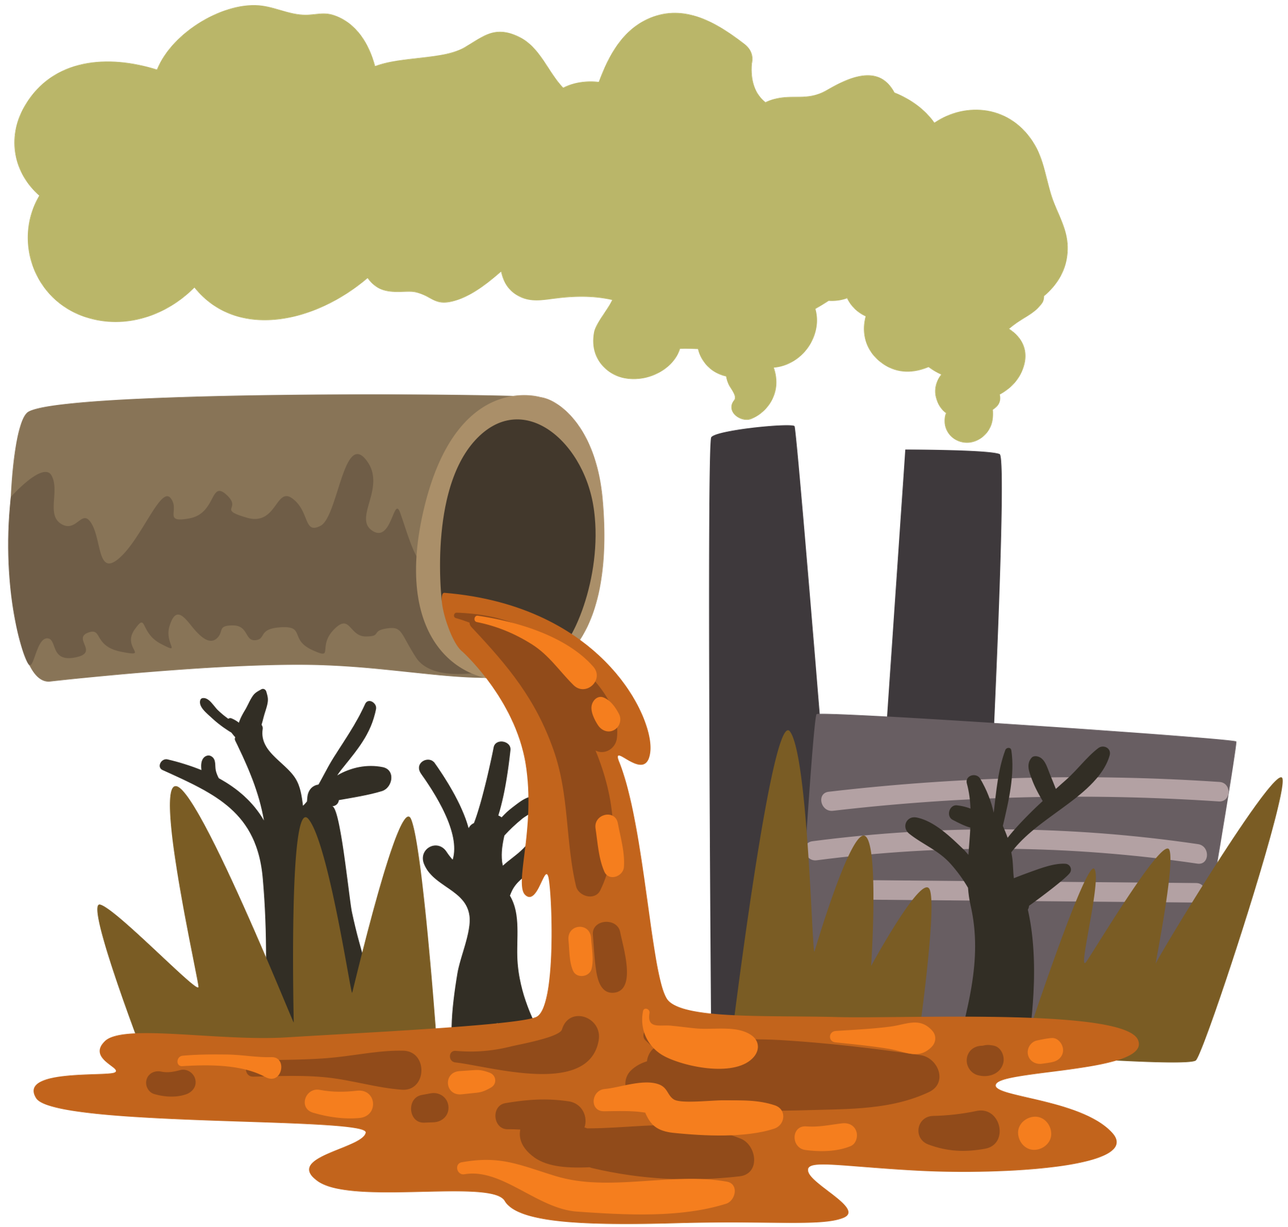
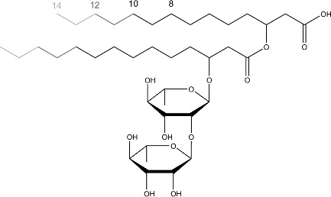
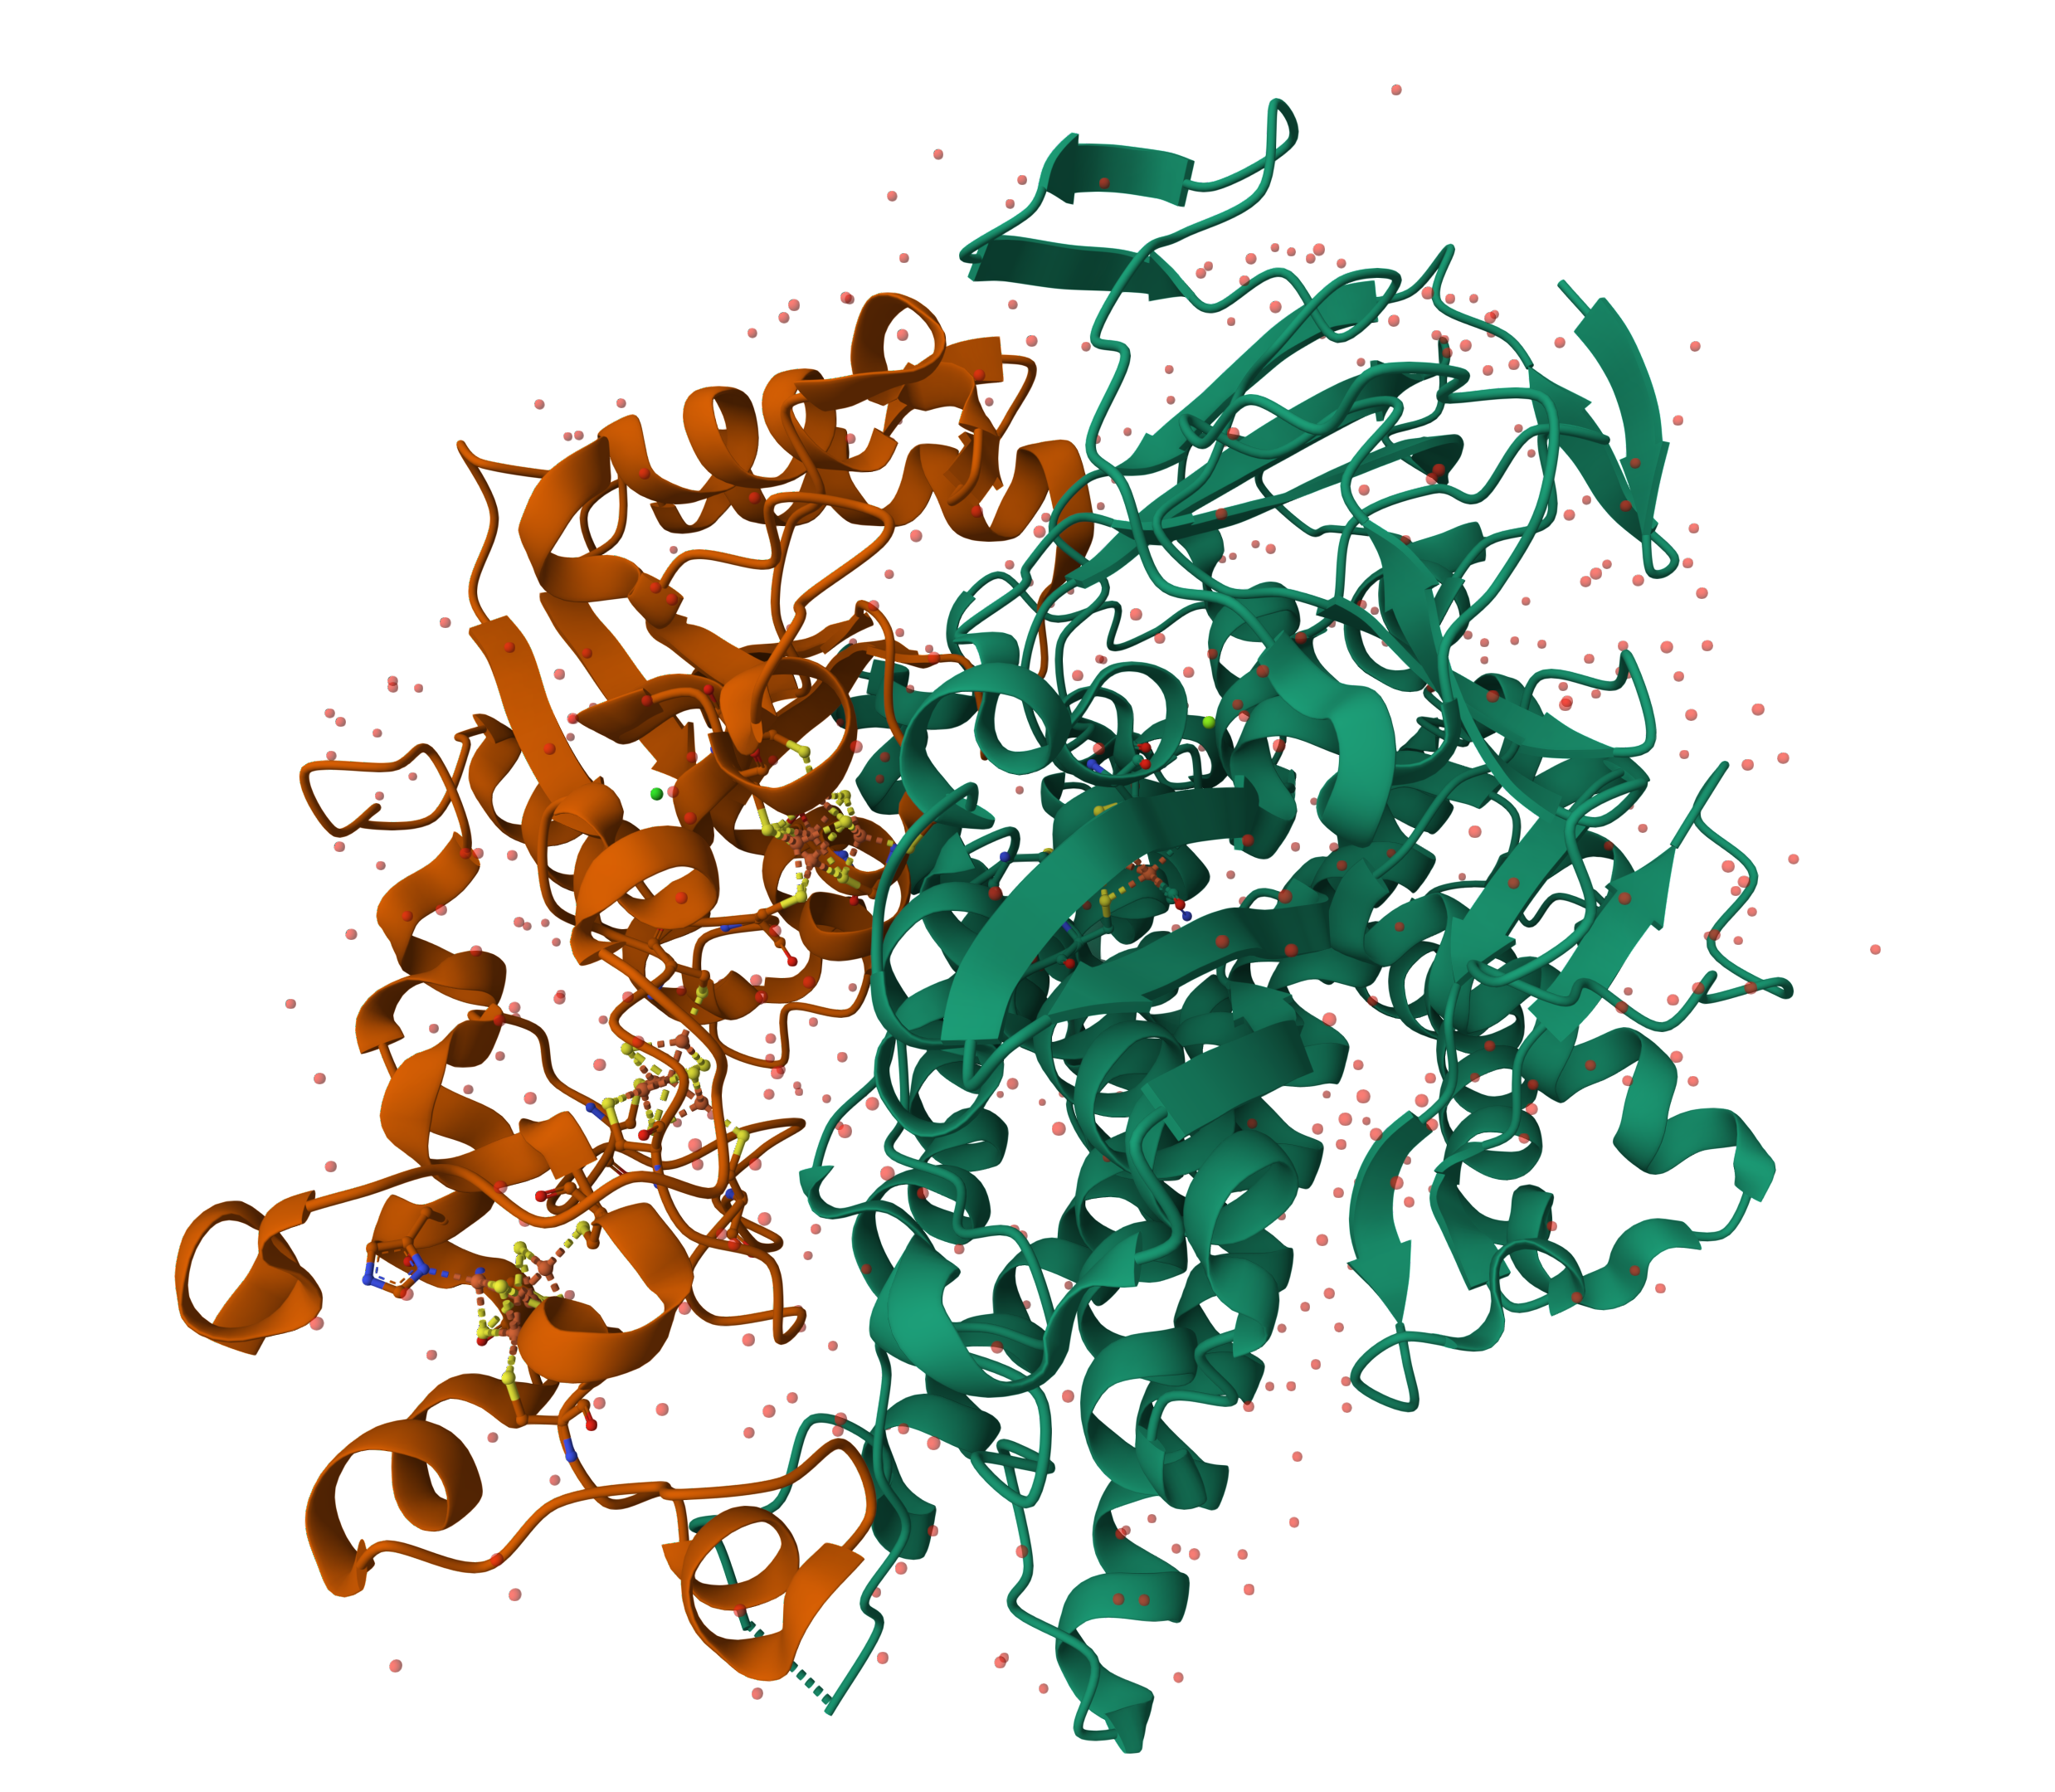
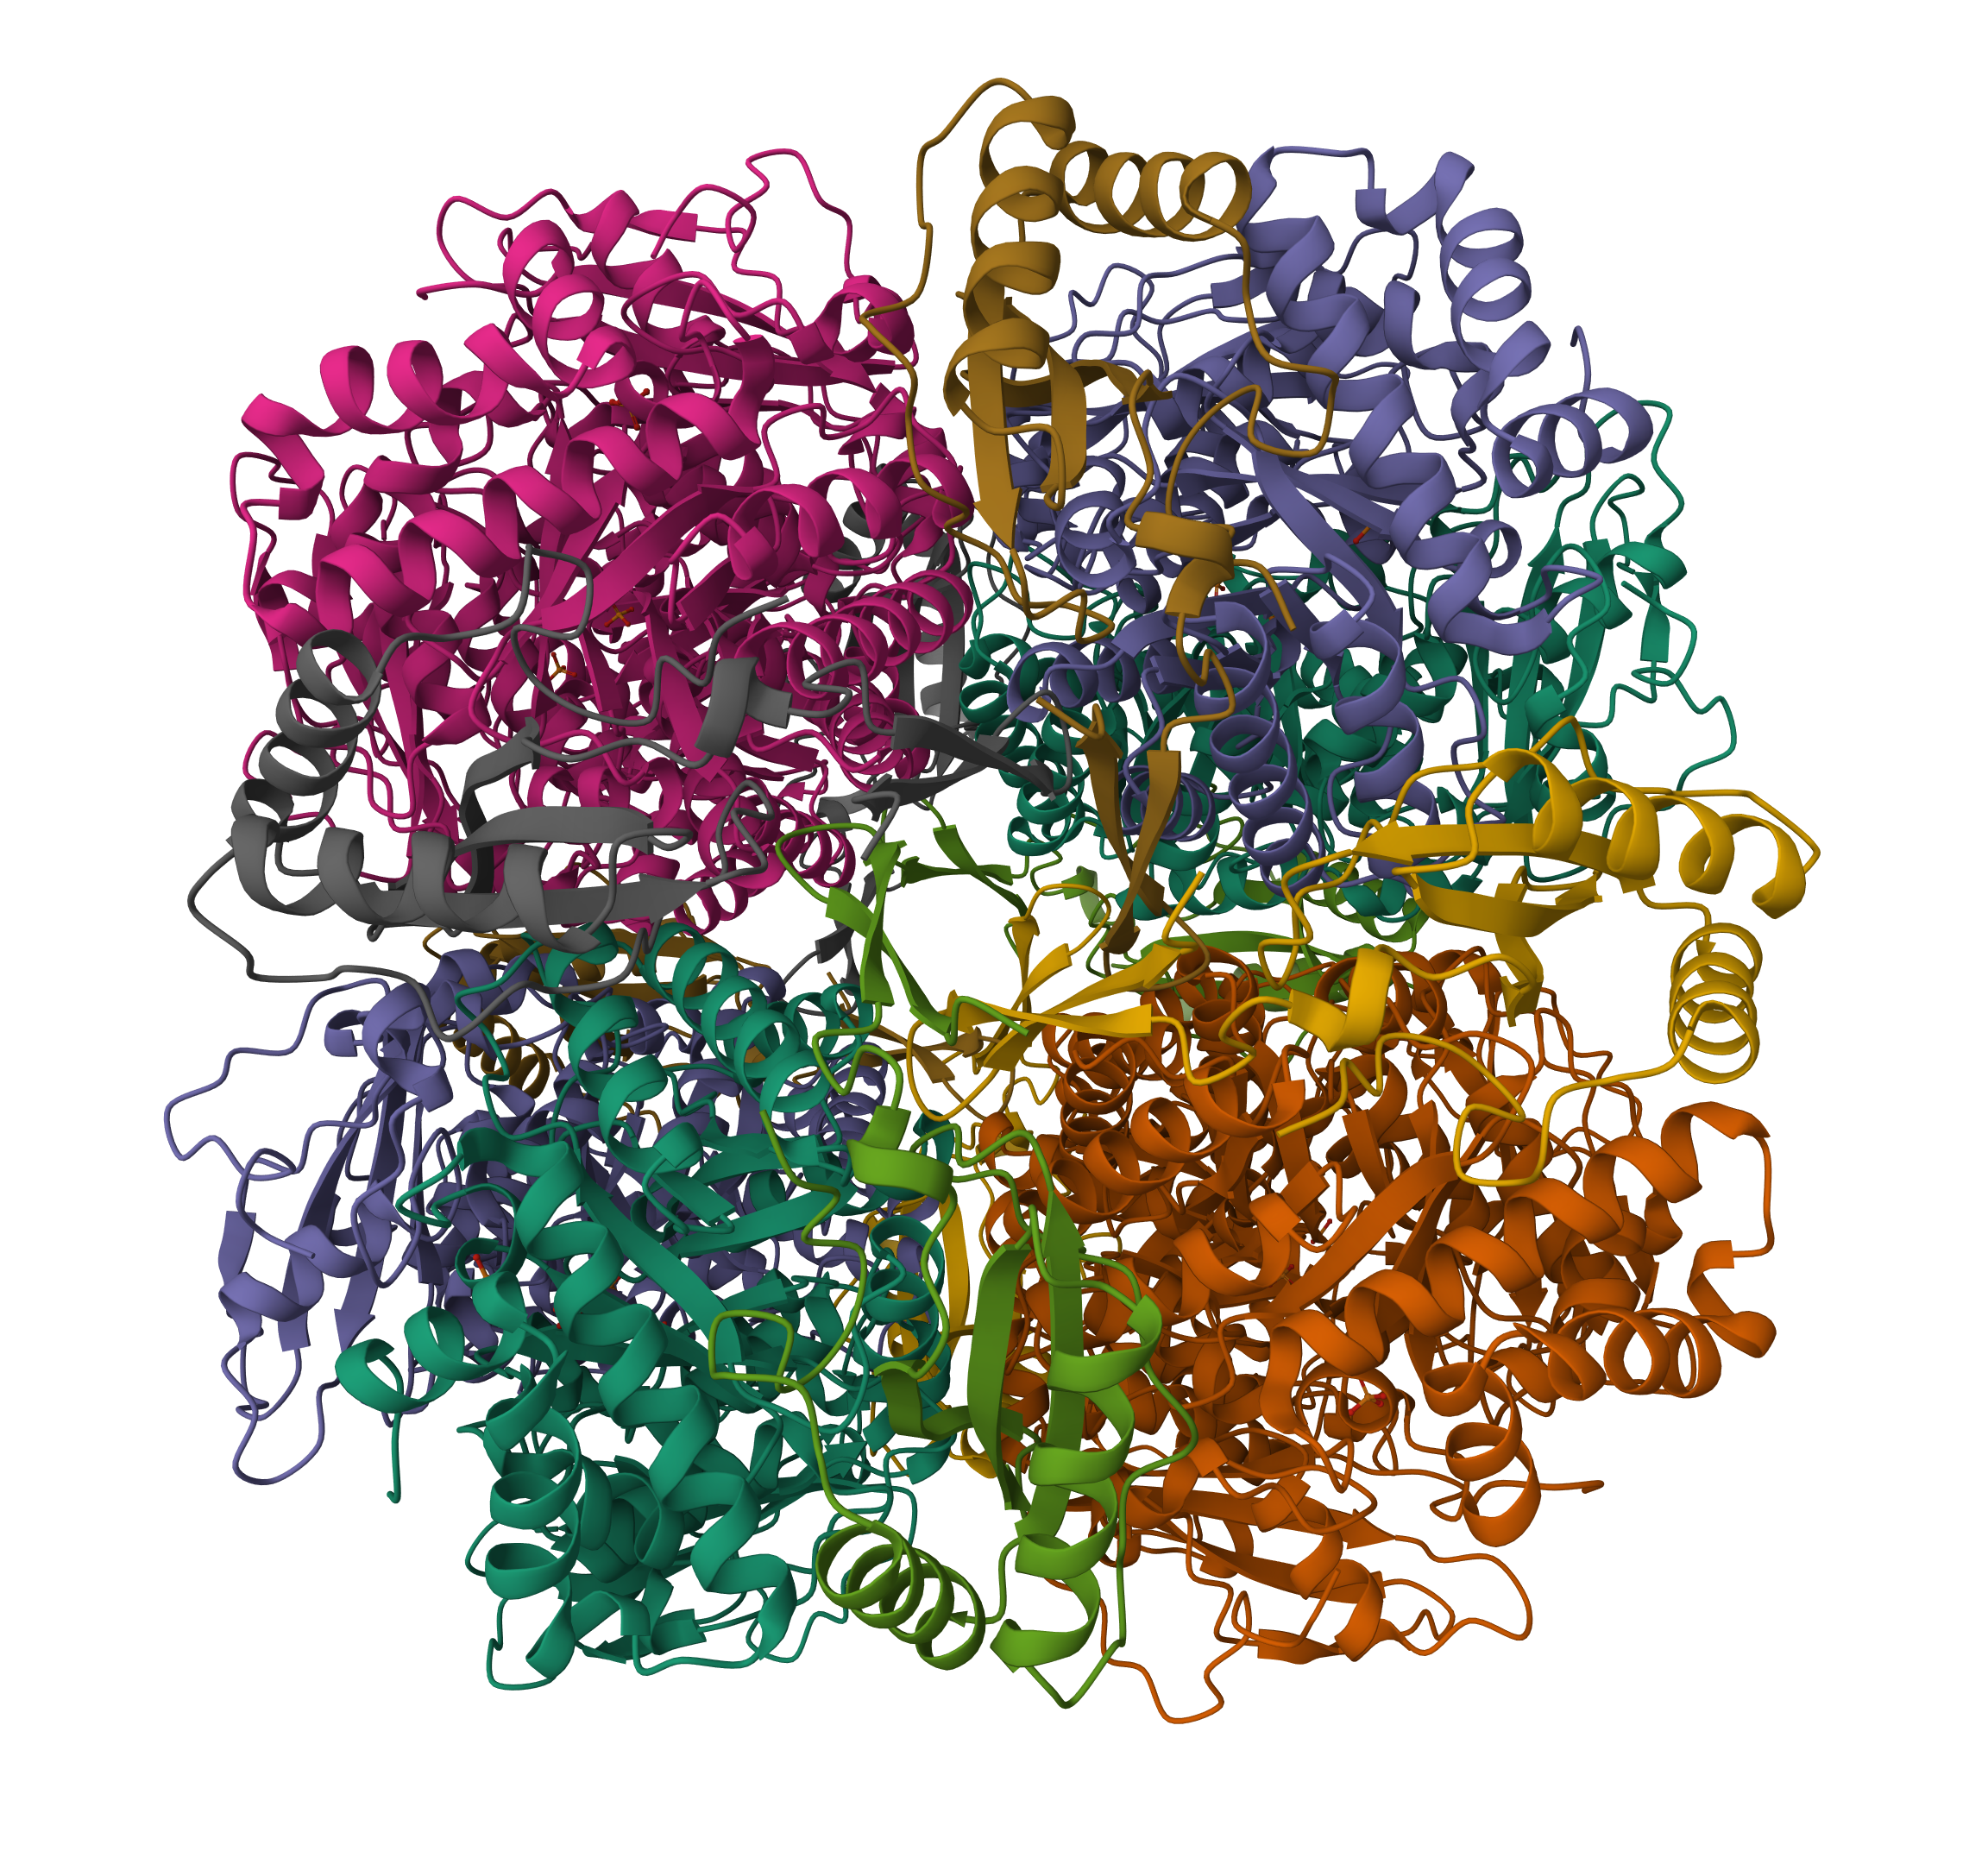
Rhamnolipids production in C. necator H16
PHB
Acetyl-CoA
rhlA + rhlB (rhamnosyltransferase chain A & B) from Pseudomonas aeruginosa PA01
Germer, Andrea et al. Applied and environmental microbiology vol. 86,6 e02317-19. 2 Mar. 2020, doi:10.1128/AEM.02317-19
Tiso Till, et al. (2015), Springer Protocols Handbooks, https://doi.org/10.1007/8623_2015_60
Notes:
Another project was about production of HAAs and rhamnolipids in autotrophic conditions. Rhamnolipids are biosurfactants that thanks to their phisico-chemical properties can be applied to a wide variety of fields, ranging from pharmaceuticals, to cosmetics, production of detergents and bulk chemicals, to agriculture and bioremediation.
The metabolic engineering strategy identified for the production of this compounds involved the expression of the rhamnosyltransferase chain A and B from pseudomonas aeruginosa in a C. necator strain with a deletion in the PHB operon, in order to improve the precursor availability for the synthesis of the biosurfactants.

Slide 13
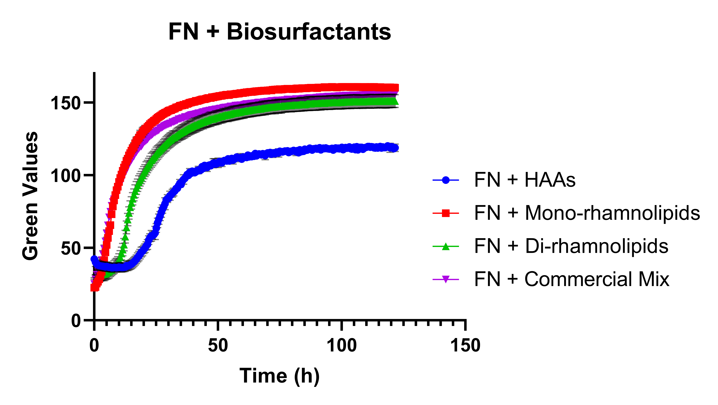
Rhamnolipids production in C. necator H16
Germer, Andrea et al. Applied and environmental microbiology vol. 86,6 e02317-19. 2 Mar. 2020, doi:10.1128/AEM.02317-19
Tiso Till, et al. (2015), Springer Protocols Handbooks, https://doi.org/10.1007/8623_2015_60
Notes:
First, degradation studies were done, and you can see here on the left that cupriovaidus was able to grow using HAAs as the only carbon source, but not the rhamnolipids. Degradation was tested also in the presence of another carbon source, in this case fructose.

Slide 14
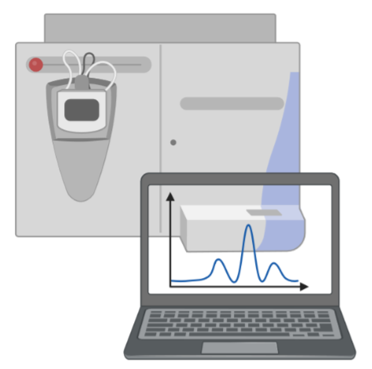
Rhamnolipids production in C. necator H16
HPLC analysis
Germer, Andrea et al. Applied and environmental microbiology vol. 86,6 e02317-19. 2 Mar. 2020, doi:10.1128/AEM.02317-19
Tiso Till, et al. (2015), Springer Protocols Handbooks, https://doi.org/10.1007/8623_2015_60
Notes:
Broth samples were taken after the cultivation and analysed with HPLC with a quantification method for HAAs and rhamnolipids.

Slide 15
Rhamnolipids production in C. necator H16
HAAs are completely degraded
HPLC analysis
Rhamnolipids are not degraded
Germer, Andrea et al. Applied and environmental microbiology vol. 86,6 e02317-19. 2 Mar. 2020, doi:10.1128/AEM.02317-19
Tiso Till, et al. (2015), Springer Protocols Handbooks, https://doi.org/10.1007/8623_2015_60
Notes:
The results showed that HAAs were completely degraded, while rhamnolipids not.

Slide 16
Rhamnolipids production in C. necator H16
Expression of rhlA & rhlB in pMVRha
Germer, Andrea et al. Applied and environmental microbiology vol. 86,6 e02317-19. 2 Mar. 2020, doi:10.1128/AEM.02317-19
Tiso Till, et al. (2015), Springer Protocols Handbooks, https://doi.org/10.1007/8623_2015_60
Notes:
Then rhamnolipids production was tried by expressing the two mentioned genes from pseudomonas aeriuginosa using the expression plasmid developed by ESR1 Matteo Vajente. But unfotunately, rhamnolipid production could not be detected. This could be mainly due to the very redundant metabolism of fattuy acids in cupriavidus necator, that has at least two operons for beta oxidation.

Slide 17
Rhamnolipids production in C. necator H16
Expression of rhlA & rhlB in pMVRha
No rhamnolipid production
Germer, Andrea et al. Applied and environmental microbiology vol. 86,6 e02317-19. 2 Mar. 2020, doi:10.1128/AEM.02317-19
Tiso Till, et al. (2015), Springer Protocols Handbooks, https://doi.org/10.1007/8623_2015_60
Notes:
Then rhamnolipids production was tried by expressing the two mentioned genes from pseudomonas aeriuginosa using the expression plasmid developed by Matteo Vajente. But unfotunately, rhamnolipid production could not be detected. This could be mainly due to the very redundant metabolism of fattuy acids in cupriavidus necator.

Slide 18
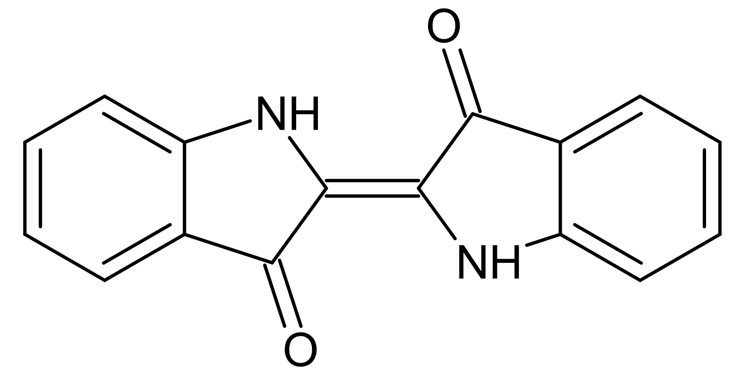
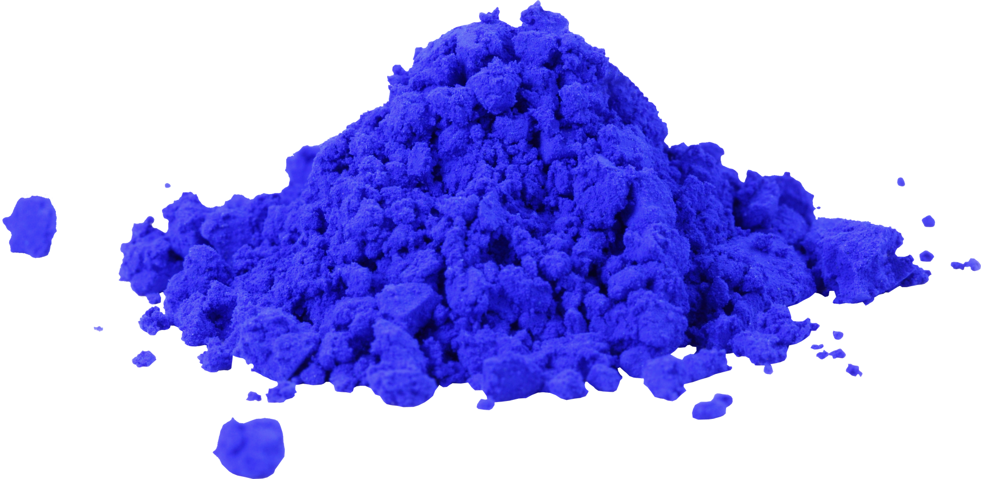
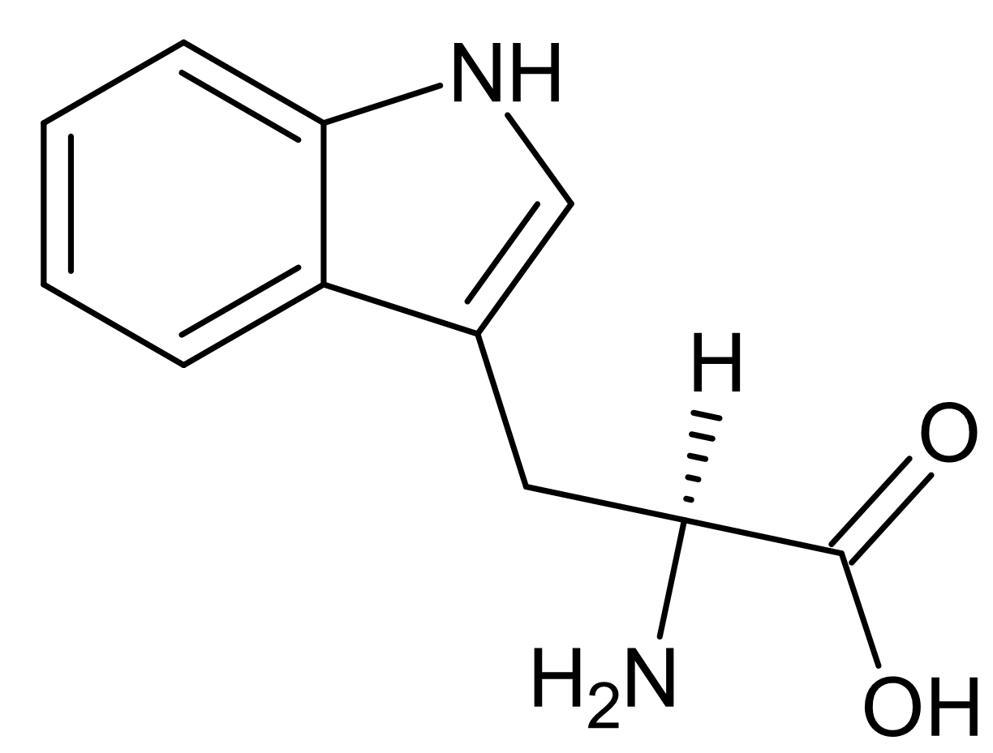
Indigo production in C. necator H16
Tryptophanase from E. coli K-12 + Naphthalene dioxygenase from Pseudomonas sp. NCIB 9816-4
Notes:
Another project focused on the production of blue indigo dye, which is the main die used in the denim fashion industry. Indigo production in bacteria has been demonstrated in the 90s and since then a lot of diffrent microbial hosts and enzymes have been tried to increase titers and yields, but no industrial biotechnological process is available to date. The strategy involved the heterologous expression of the tryptophanase enzyme from E. coli and the Naphtalene dioxuygenase from a Pseudomonas species.

Slide 19
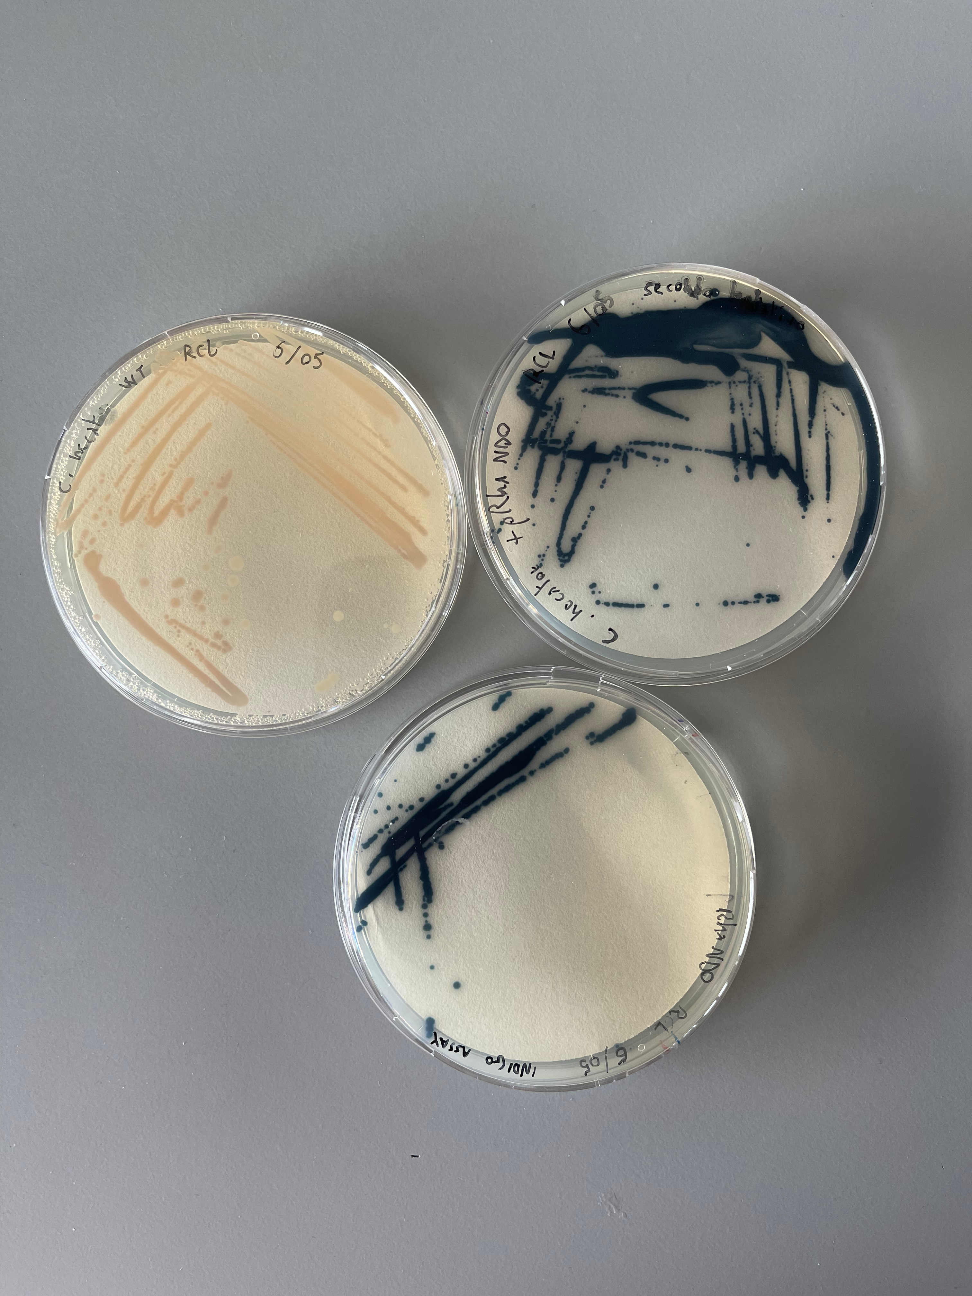
Indigo production in C. necator H16
Tryptophanase from E. coli K-12 + Naphthalene dioxygenase from Pseudomonas sp. NCIB 9816-4
Notes:
By expressing this two enzymes we obtained a Cupriavidus necator strain able to produce indigo in heterotrophic conditions. We then cultivated this same strain in autotrophic conditions, achieving a proof-of-concept production of indigo through gas fermentation. More tudies will follow with the goal to improve titers and yields. Also, new enzymes and growth conditions will be tested to try and produce indigo derivatives interesting from a commercial point of view.

Slide 20
Take-home messages
High efficiency electroporation and streamlined cloning is now possible for expression plasmids, but…
New synthetic biology tools required to improve the genetic accessibility of C. necator H16
Proof-of-concept production of value-added chemicals in C. necator, but…
In-depth studies of its metabolism are required to make it a robust chassis strain
Notes:
So what are the main take-homer messages from WP1:

Slide 21
This project has received funding from the European Union’s Horizon 2020 research and innovation programme under the Marie Skłodowska-Curie grant agreement No 955740.
This presentation reflects only the author's view, the Agency
is not responsible for any use that may be made of the information it contains.

